Slide 1
CORE Defined– Corporate Unified Onboarding
February 2024
Linda Bevolo
Saad us Salam
Rashid Hussain
Pavan Ganjam

Slide 2
Contents and Change Log
Contents
Change Log

Slide 3

Corporate Unified Onboarding Capabilities
Feature | Capability | Reuse | Core | BL Use | 2023 Capabilities | Roadmap Items
Digital Experience | Client Dashboard Onboarding Tracker | High |  |  | View account milestones, status and take action | One customer view across products
Digital Experience | Employee Dashboard Event Summary | High |  |  | Onboarding summary, assignment, milestone status and tasks | Add graphs for process mining. Common object model
Digital Experience | Document Management | High |  |  | Document upload/download, eSign, document negotiation, package management | Add OneSpan cloud
Digital Experience | Document Generation | High |  |  | PDF/word document generation
 | Data collection (Dynamic Form Framework) | High |  |  | Data collection for workflow | Inline JSON editor, Field level annotation, nested card support
Digital Experience | Onboarding Event 360° view | High |  |  | Single view of onboarding event data, tasks, documents, history
 | Datapoint Configurator | Med |  |  | Datapoint editor supports QC audit before account is opened in SOR
 | Change History | High |  |  | Audit log of all workflow business activities and all data changes
 | Periodic/on-demand reviews | Med |  |  | Trigger periodic reviews
 | Pricing/Fee Schedule Editor | Med |  |  | Update fees and track changes
Workflow and Business Rules | Workflow/Business Rules | High ODM |  |  | Robust Enterprise grade workflow & rules engine using web modeler. Customized for specific Product/BL
 | Auditability | High |  |  | Audit log of workflow and business rule changes
Core Product – Ready to use capabilities with configurations at varying levels of maturity
IT&C
GFS
GCT
PT
MC
DPG
FBO
FX
Part of Core Platform

Slide 4
Corporate Unified Onboarding Capabilities
Features | Capability | Reuse | Core | BL Use | Description
Shared Enterprise Capabilities | User Provisioning Roles/Privileges | Med |  |  | Provision client’s users for onboarding events Employee provisioning using LDAP groups | User provisioning for Singlepoint OU
Shared Enterprise Capabilities | KYC | High |  |  | Search, retrieve and create KYC profile | Integrate into OneKYC
Shared Enterprise Capabilities | Communication | Med |  |  | Integrate with enterprise Communication hub to support client communications
SOR Integrations | Common Integrations e.g., Fee/Billing systems/ SWP | Med |  |  | Fetch common fee schedules and track changes, Advantage Fee
SOR Integrations | Business Line (BL) specific System integrations | Low |  |  | Automate setups in downstream systems (10+) | Additional BL SOR's
SOR Integrations | Salesforce Integration | High |  |  | Push and Pull data from Salesforce | Additional salesforce instances
Data & Analytics | Web analytics – Adobe Analytics/Quantum Metric | High |  |  | Reporting, visualizations, and analysis of user behavior/application usage | Standard process mining reports
Core Product – Ready to use capabilities with configurations at varying levels of maturity
IT&C
GFS
GCT
PT
MC
DPG
FBO
FX

Slide 5
Unified Onboarding Platform Capabilities (DRAFT)
Pre Sales & Sales
Employee Experience
Client Experience
Auth
CIP & KYC
Document Management
Communication Flows
Account Setup
Post Account Setup
Reporting & Analytics
Opportunity Setup
Salesforce (GFS, CCRM)
Others
Employee Dashboard
(f.k.a Level 1
Collaboration Portal)
Client Dashboard
(f.k.a Level 1)
SSO - Hub
CIP Decision Engine (Simility)
EDM APIs
Upload/download/search
Configurable Email Template
Hogan CIS
Corp Hub Integration
Adobe Analytics
Client Enrollment Login- Hub (credentials)
Create/update/search KYC Profile (One KYC API) - WebKYC
Comm. Hub API
SOR API Integration
Leverage existing/ build new
SWP
Calypso
WSS
VAM
Others
Salesforce Integration - update
Quantum Metric
Task Details
Data Entry Form
Documents
eSign
FileNet Integration
Event Details (f.k.a Level 2)
Qualtrics
Digital Packet Creation
General marketing material
Fee proposal
Content Generation Service(pdf)
Chat
Virtual/Human Agent
Money Movement Integration
RTP/WIRE
Task Details
(f.k.a Level 3)
OTP - Email
Power BI? reports/
dashboard
Common Intake
Data/Doc
Manual Review of KYC/IDP alerts
Alerts Notifications
Initiate Onboarding
eSign Integration - OneSpan
Online Banking Integration
SMS
Define/
implement Data Strategy
U.S. Bank Customer Search/prefill
Ops Team Dashboard
Contract Lifecycle Mgmt.
nCino Integration
Credit limit
Pivot Integration
Create/update/search KYC Profile (Omni)
Co-browse
Common Intake
Data/Doc
Hogan DDA
DPG Portal (FX) Integration
Data Extraction APIs- OCR
Client onboarding access
Markets Portal Integration
Automated data/doc purge
Tag/classify
Contract Negotiation (DPG/FX)
SinglePoint Integration
CMOD Integration
Trade Point (Trade Finance Integration
Fee Negotiation
(GFS)
Asset Movement / Conversion
Employee Entitlements
Dynamic form framework
Workflow Management
Rules Management
Data retention
Ref Data Mgmt. Utility
Task Status
Task Assignment
Other…
Existing Capabilities
In Progress/On Roadmap
Existing Horizontal Capabilities

Slide 6
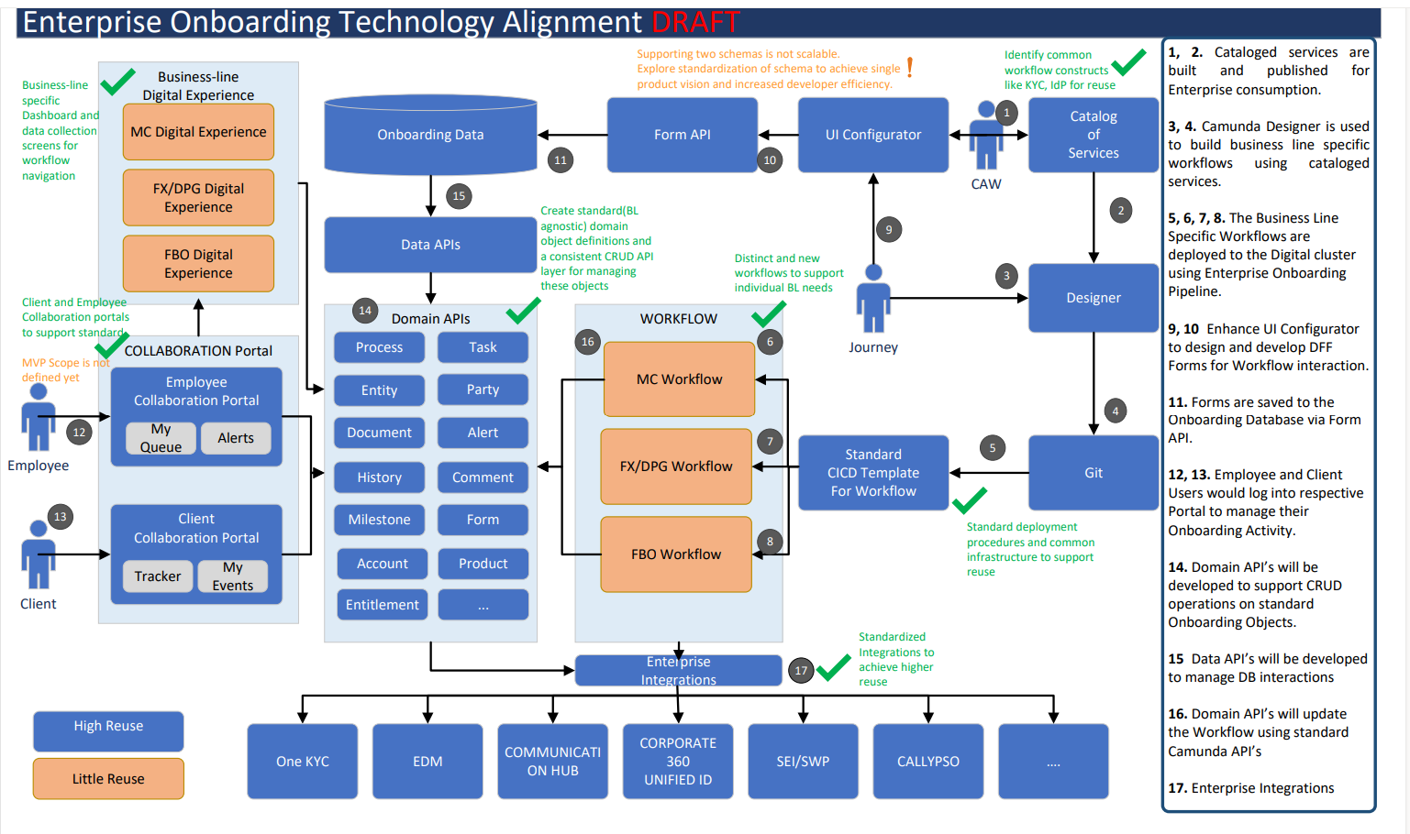

Slide 7
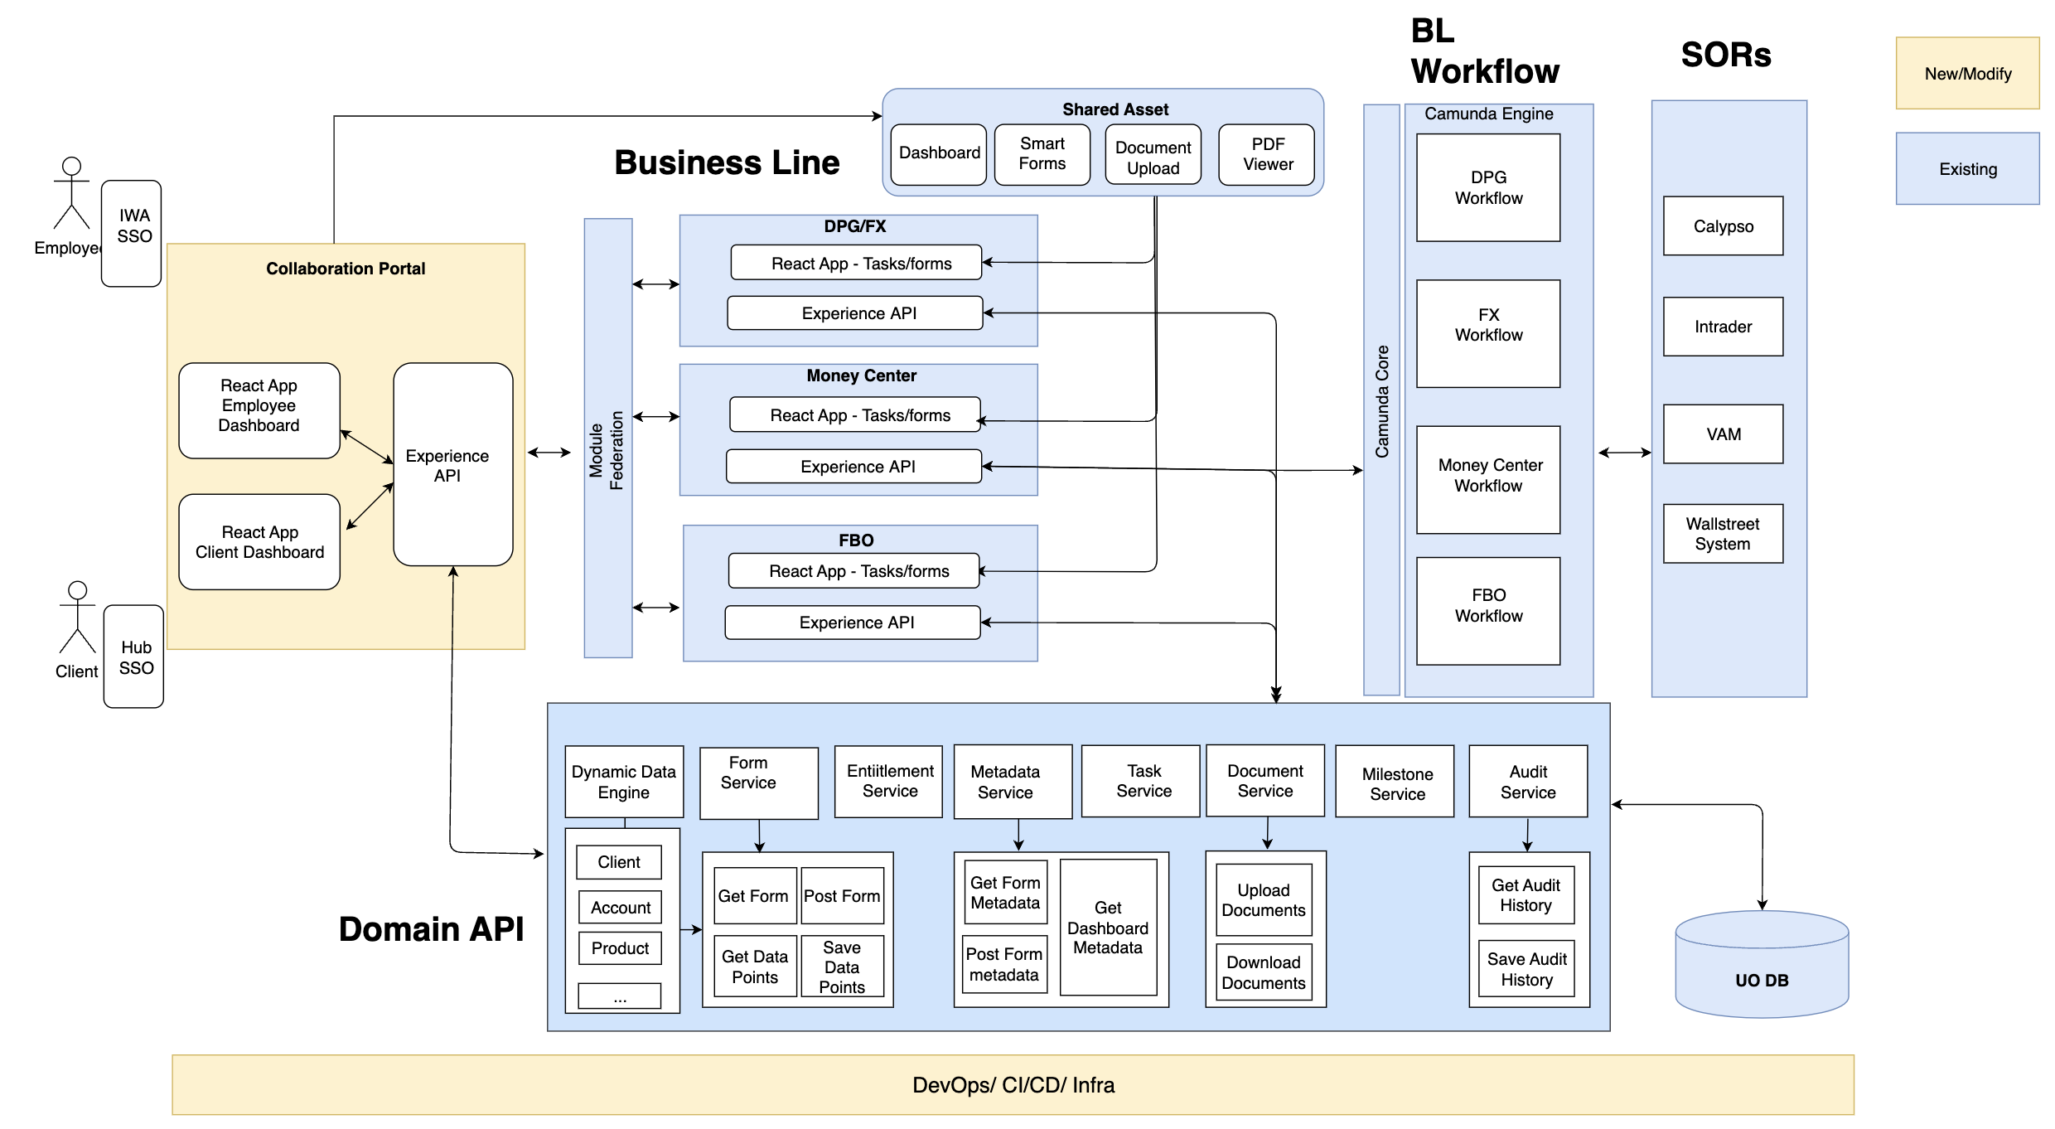
Technical Design
UI Core Repo
API Core Repo
Technical Design
Level-1 common collaboration portal will be created for client and employee view
BL apps will implement if any custom dashboards needed
BL apps will implement workflow tasks, data collection forms
Dynamic form framework will be used to implement UI forms
BL apps will implement e2e workflow in Camunda
Dynamic data engine will be used to work with onboarding domain objects, e.g. Client, Account, Product etc.
A set of reusable APIs are created for common functionalities e.g. entitlement, audit trail, tasks, documents

Slide 8
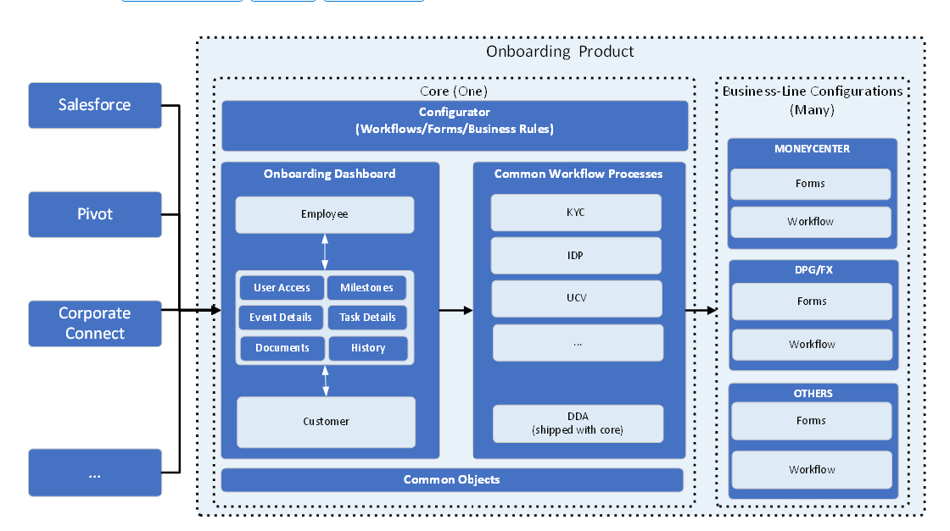
CORE Design
Later
UO Platform Capabilities (DFF)

Slide 9
CORE Design
Client
CUST
CIP
KYC
Employee
CORE
BL Journey A
Client
Employee
CORE
Client
BL Journey B
CORE
CORE
CORE
Employee

Slide 10
Unified Onboarding – Core 1.0 Defined
Single run time delivered in a vendor like product with dev level configurations
Standard onboarding experience for WCIB/Payments(Non-consumer) within USBNA
Employee Experience
Employee Dashboard (L1)
Create new onboarding
Single onboarding event with one customer
Sales, FO, MO, BO personal
Event Details (L2)
Task Details(L3)
UCV – Customer Select/Create
KYC – Create or Select
CIP - check
Client Provisioning
Client Experience
Corp Connect
USBNA Customer, USB Logo’s, USB Branded
Customer available in USBNA Hogan CIS
Entitlement tied to user (email) – SinglePoint
Accounts tied to Client Selected/created in Onboarding
New Onboarding product
Onboarding
Client Dashboard
Client Common Intake form
Client Task Details (container)
Core onboarding Process
UCV
Search/Select Client in Hogan CIS (is this a USBNA customer)
Create new client in Hogan CIS (Create a USBNA customer)
KYC
On Client created above or search KYC is Client above existed
CIP Check
Not in Core 1.0
Customer of Customers
Consumer Customers on WM or USBii
Alternative customer experiences outside of Corp Connect
White labeling
Pivot
SinglePoint
BL specific
Workflows
Data collection forms
Multiple customers assigned to One product

Slide 11
Unified Onboarding – Core 1.0 Customer of Customer – Impact assessment
Single run time delivered in a vendor like product with dev level configurations
Standard onboarding experience for WCIB/Payments(Non-consumer)
Employee Dashboard (L1)
Create new onboarding
Single onboarding event with one customer
CoC –Additional dashboard?
2 dashboards or change current one
Multiple events?
Sales, FO, MO, BO personal
Event Details (L2)
Task Details(L3)
UCV – Customer Select/Create
Identify a Usbank customer so that we can attach the onboarding to the correct customer
Open a Hogan CIS account if not found - change
Parms for Hogan CIS set up - change
What is set to determine COC
For COC do not attach to Hogan CIS
KYC – Create or Select
COC – Parms for KYC set up. CoC should be in KYC
How COC identified. How customer determined
CIP - check
Client Provisioning – for COC – OTP how know?
Corp Connect
USBNA Customer, USB Branded
Customer available in USBNA Hogan CIS
Entitlement tied to user (email) – SinglePoint
Accounts tied to Client Selected/created in Onboarding
New Onboarding product
OTP – Change – separate experience, separate logo
Only onboarding events – no other products
Onboarding
Client Dashboard
Client Common Intake form
Client Task Details (container)
UCV
Search/Select Client in Hogan CIS (is this a USBNA customer)
Create new client in Hogan CIS (Create a USBNA customer)
KYC
On Client created above or search KYC is Client above existed
CIP Check
Client Experience
Employee Experience
Core Onboarding Process

Slide 12
2024 Onboarding Roadmap (High level draft. Subject to Change)
Jan
Feb
Mar
Apr
May
Jun
Jul
Aug
Sep
Oct
Nov
Dec
PT
R 2.0 - Go-live – March
Initiate Onboarding, dashboard, document management, alerts & notifications
R 2.1
Bug fixes, customer feedback
R 3.0
Clone/cancel events
Prod Support & BAU
GCT
R2.1
Initiate Onboarding, Risk Approval
R3.0
SWP user tasks for CME and GSF, SWP integrations, FLAG framework
R4.0 – SWP Event 3b
Enabling CDO BL on Initiate Onboarding, Risk Assessment, Approvals and SWP tasks in addition to SWP new APIs and update to existing APIs
Prod Support & BAU
MC
R1 - Go-live - April
E2E onboarding for MSA on file Clients
R2
Non-MSA clients
R3
SOR Integration- TPG(The Portfolio Genius)
TBD
FBO
Multi-VAM per participant
Participant intake UI
Participant Bulk upload
Multi-TIN VAM
TBD
DPG/FX
DPG Go live – April
DPG- Marketer, Regulatory O
R2
Calypso account setup, Salesforce opportunity
FX rollout (to be confirmed)
Spot/Non-spot trade products, Marketer, Regulatory Onboarding, WSS account Setup
TBD
SCF
R1
Sales team -Initiate onboarding, prefill, supplier – provide data/doc, legal team review
R2
eSign, automate backoffice flow
TBD
AH
Participant data collection, CIP, KYC, Hogan CIS/DDA
TBD
USBAM
LGIP – Investor onboarding workflow
Collect data per state funds, review, sanction screening
TBD
Core*
Core Foundations
2023 - Corp Commons, Single Runtime POC, Form/Frame PoC
Core MVP – MC/DPG rollout - Dashboards, Form and Frame, UCV
Customers of Customer (AH,SCF) - Design Object Model, Dashboard
Core 1.0 - Customers only
KYC, CIP, DDA
Core 2.0 - Customers of Customer
KYC, CIP, DDA
* Core strategy and implementation started in 2023. Corporate Commons Objects and API implementation was the first significant deliverable of Core in 2023.
Existing workstreams from 2023.
New workstreams for 2024.

Slide 13
Onboarding Roadmap
Q3 23
Q4 23
Q1 24
Q2 24
Q3 24
Q4 24
Q2 25
PT
R 2.0 - Go-live – March
Initiate Onboarding, dashboard, document management, alerts & notifications
R 2.1
Bug fixes, customer feedback
R 3.0
Clone/cancel events
Prod Support & BAU
GCT
R2.1
Initiate Onboarding, Risk Approval
R3.0
SWP user tasks for CME and GSF, SWP integrations, FLAG framework
R4.0 – SWP Event 3b
Enabling CDO BL on Initiate Onboarding, Risk Assessment, Approvals and SWP tasks in addition to SWP new APIs and update to existing APIs
Prod Support & BAU
MC
R1 - Go-live - April
E2E onboarding for MSA on file Clients
R2
Non-MSA clients
R3
SOR Integration- TPG(The Portfolio Genius)
TBD
FBO
Multi-VAM per participant
Participant intake UI
Participant Bulk upload
Multi-TIN VAM
TBD
DPG/FX
DPG Go live – April
DPG- Marketer, Regulatory O
R2
Calypso account setup, Salesforce opportunity
FX rollout (to be confirmed)
Spot/Non-spot trade products, Marketer, Regulatory Onboarding, WSS account Setup
TBD
SCF
R1
Sales team -Initiate onboarding, prefill, supplier – provide data/doc, legal team review
R2
eSign, automate backoffice flow
TBD
AH
Participant data collection, CIP, KYC, Hogan CIS/DDA
TBD
USBAM
LGIP – Investor onboarding workflow
Collect data per state funds, review, sanction screening
TBD
Core*
Core Foundations
2023 - Corp Commons, Single Runtime POC, Form/Frame PoC
Core MVP – MC/DPG rollout - Dashboards, Form and Frame, UCV
Customers of Customer (AH,SCF) - Design Object Model, Dashboard
Core 1.0 - Customers only
KYC, CIP, DDA
Core 2.0 - Customers of Customer
KYC, CIP, DDA
* Core strategy and implementation started in 2023. Corporate Commons Objects and API implementation was the first significant deliverable of Core in 2023.
Existing workstreams from 2023.
New workstreams for 2024.

Slide 14
Employee Dashboard
Event Details
Task Details
Unified Customer View (UCV)
KYC
CIP
Client Provisioning
Client Experience
Corp Connect sso

Slide 15
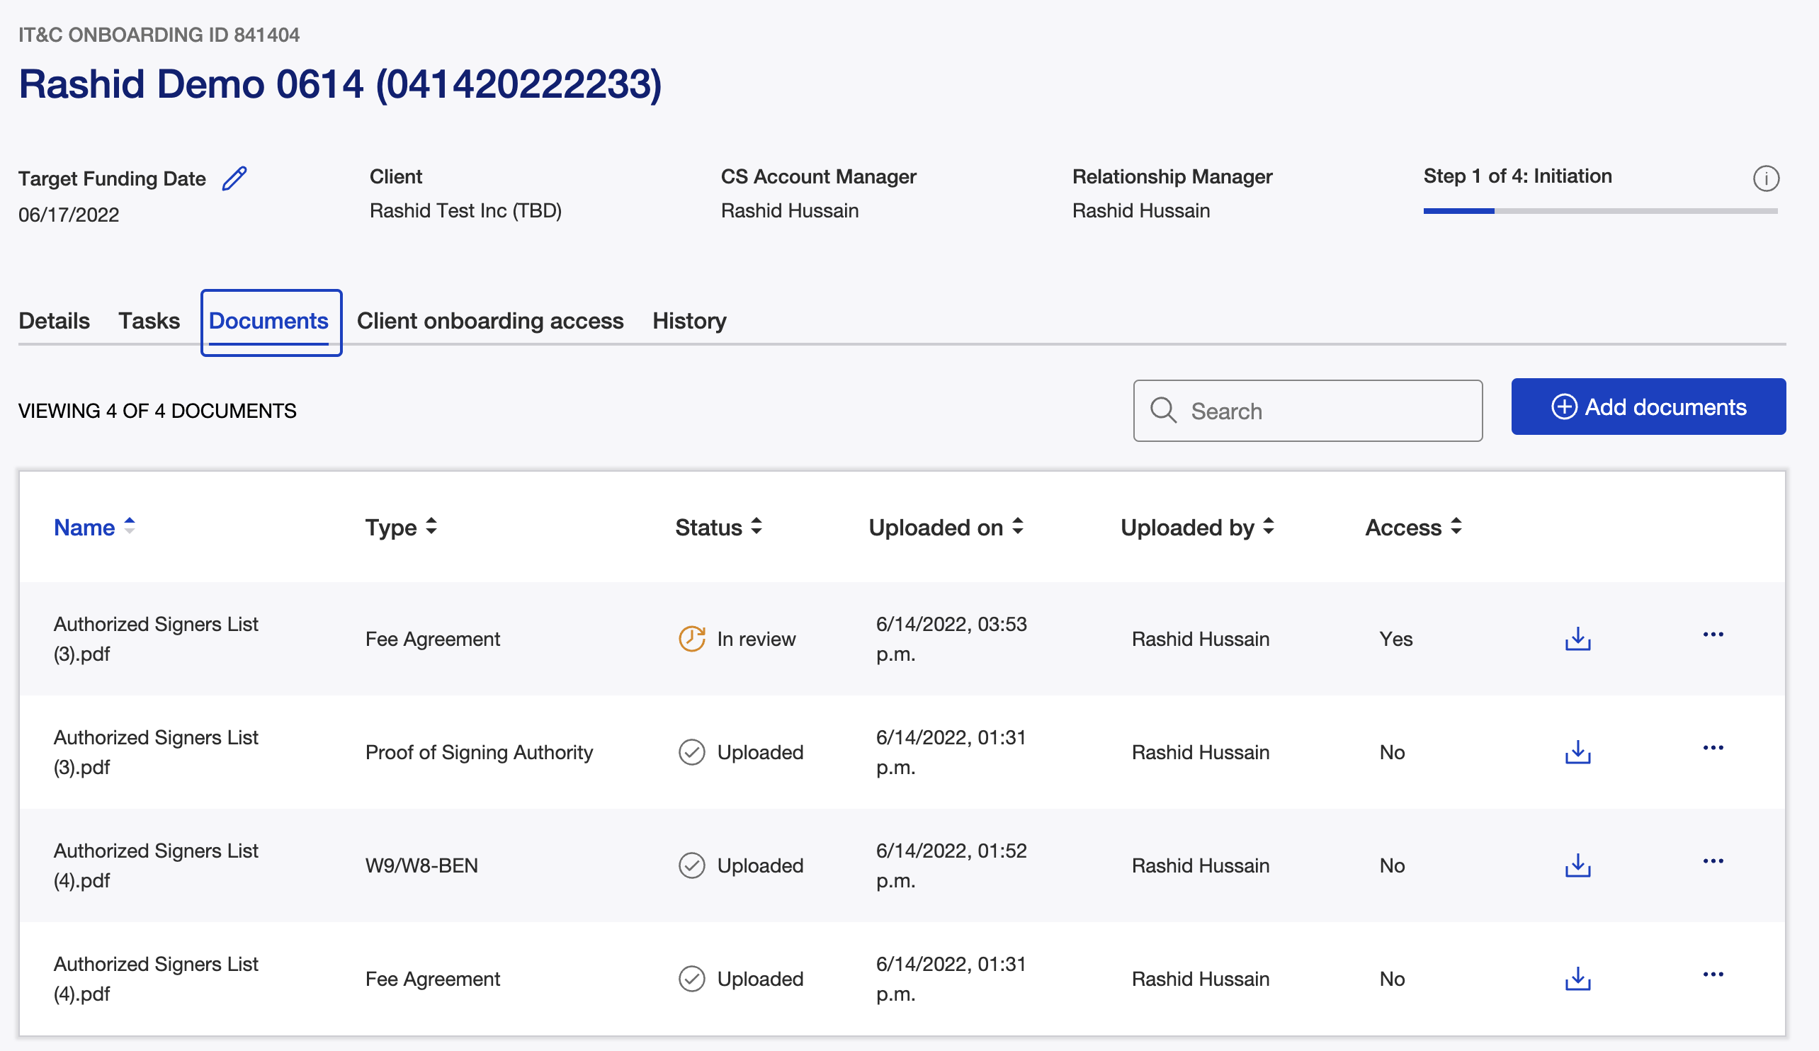
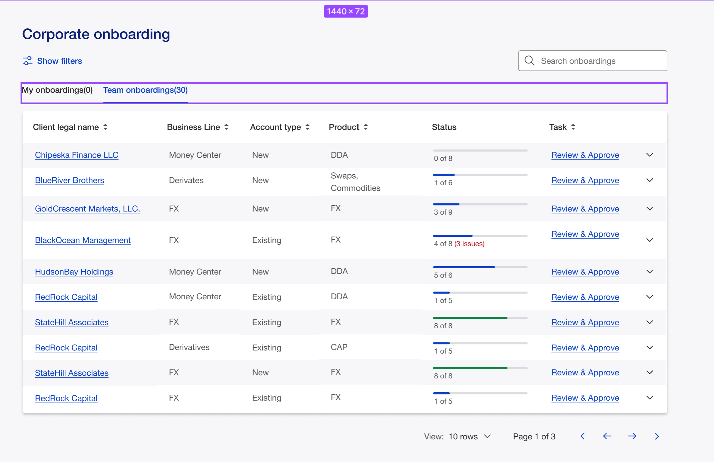
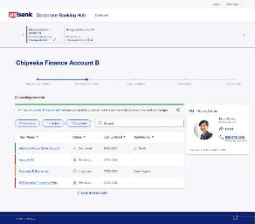
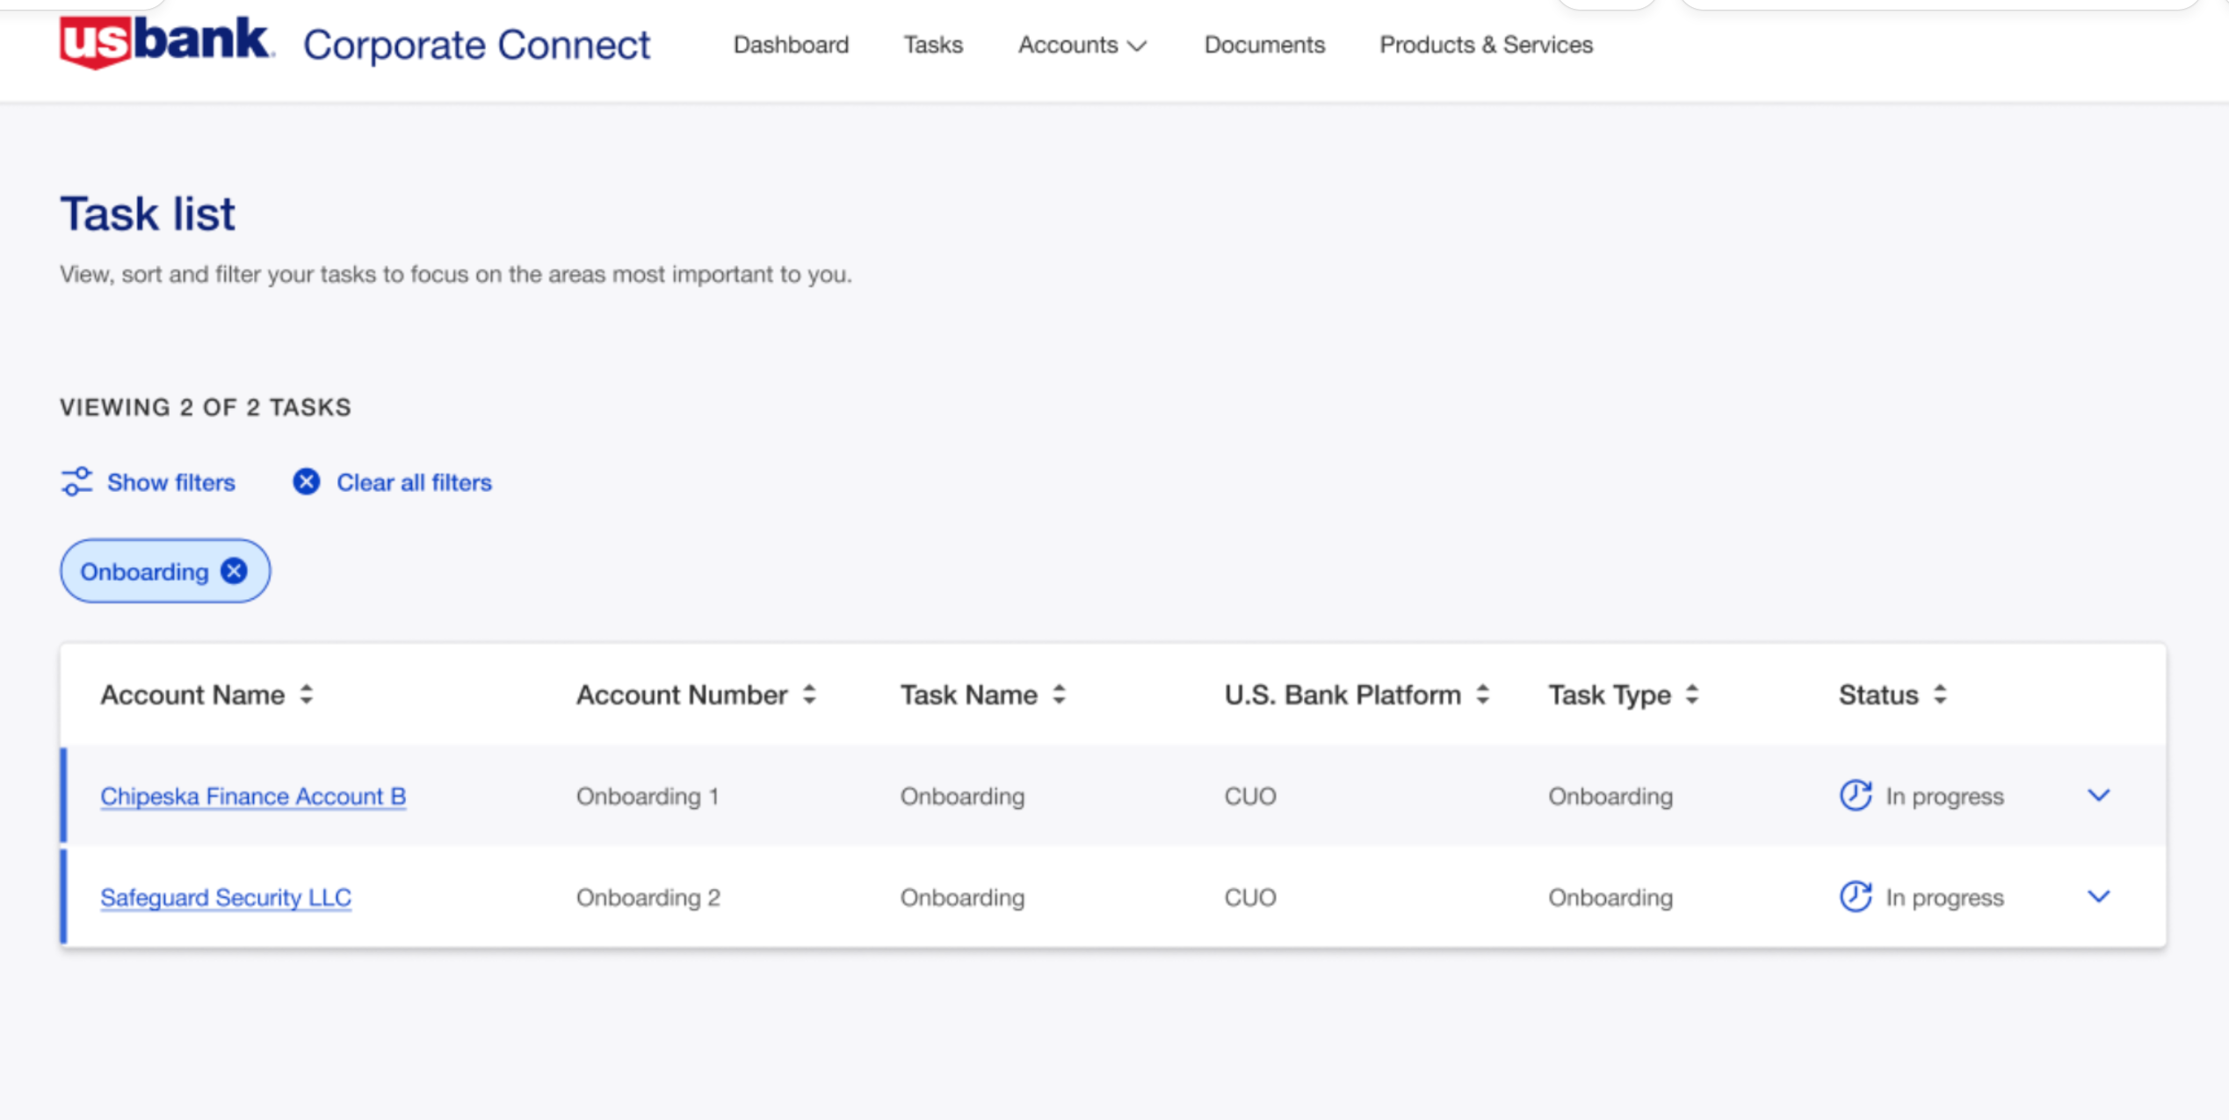
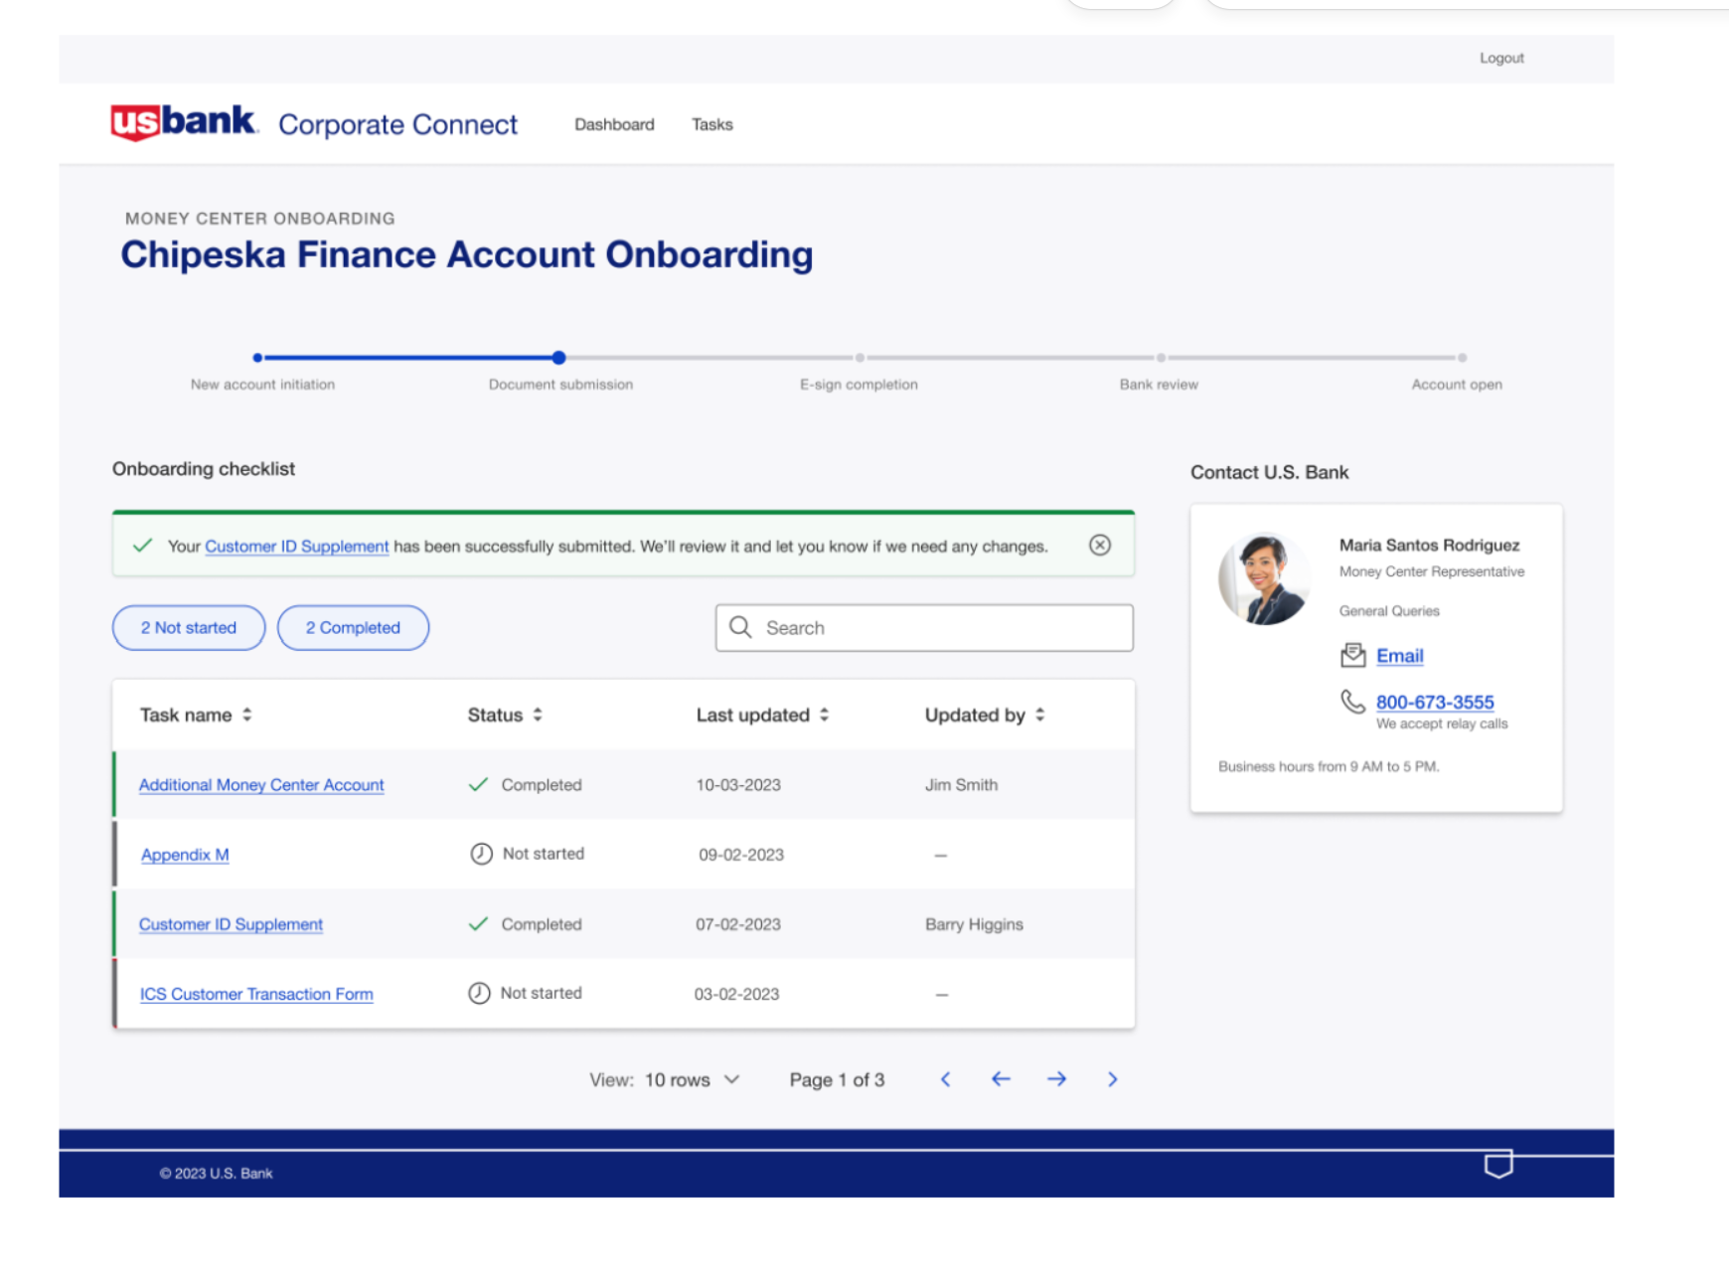
UO Core Defined
EVENT Details - Customer 360 View
Details – End to end workflow
Tasks
Reassign
Documents
History
Client Access
Employee Dashboard
Event
Workflow
Milestone
Tasks
Personas
Sales, FO, MO,BO
1 customer per event
Client Dashboard
Event
Tasks
USBANK Logo
Hogan Acct List
USBank
customers in
Hogan or
created in Hogan
Client on event
Corp Connect
Onboarding Events for USB customer
Common
Objects
Data
Process & Tasks
Entity -
Customer
Events & Milestones
Product
KYC
CIP/IDP
Roles
Common Experience
Select USB customer
Search or Create KYC Documents
Search or Create IDP
Create user
Messaging/Chat

Slide 16
Existing Approach
Future Approach/PoC
Progress
L1- Collaboration Portal
Employee Dashboard is implemented as part of BL stitching layer
Shared Assets(design time artifact) being leveraged to build L1 dashboard for a given BL and configure for various roles
Leveraging common APIs along with BL exp API layer to get the dashboard data
Employee - A common standard dashboard view for all BLs
Built and deployed as single runtime app
Built on common object model
Leveraging common set of APIs
Based on standard role definitions(FO, MO, BO etc.) which are mapped to BL specific roles
Able to build and deploy a single runtime based common collaboration portal
Being tested in IT env by UX/PM partners
Awaiting feedback and roll out planning from product mgmt.
L2- Onboarding 360 view
L2 functionality consists of onboarding metadata, client details, tasks, documents, audit trail tabs
It also has been implemented as part of BL stitching layer
Shared Assets(design time artifact) being leveraged to build 360 view for a given BL
Leveraging common APIs along with BL exp API layer to get the data
Implement and deploy as part of common collaboration portal
Standardize top panel metadata and tabs
Content of Client details tab to be standardized with read only view
Audit trail is already a standard view across BLs, no change needed
Documents – make the UI view standard, ability to configure BL API end point to get relevant documents and keep implementation in BL Exp API layer to connect to the right doc repo and apply role-based rules
Tasks – Standardize task view/actions and leverage BL Exp API to get data
Had couple of brainstorming sessions as a group
Have alignment on what is expected
Will be able to share some updates by next week
L3 - Forms
L3 form implementation is part of BL stitching layer run time app
Dynamic form framework is being utilized to configure forms metadata
Whole form UI is wrapped into a parent component
Divide the L3 into frame(left & top panels) and form(main body)
Make frame part of common collaboration portal run time and use configuration to get the content
Form implementation will be part of BL stitching layer leveraging Dynamic form framework
Enable communication between Frame & Form to cater to the dynamic behavior based on use action
Explored various options e.g. iFrame, Webpack module federation
Dropped iFrame one due to security concerns around XSS vulnerabilities
Initial results are positive and we are able to load form content from a BL stitching runtime
At common collaboration portal level, to onboard a new BL, it will require only config change in Webpack config file to add new plugin

Slide 19
Now Next Later
Now
Next(2024)
MVP
Target
Later(2025+)
Client Dashboard
/Tasks
Common standard client dashboard providing milestone tracking, tasks and USB contacts
Single runtime for all BL/Products following corporate
Adoption - MC
Plan to onboard new BLs with direct U.S. Bank client onboarding
Implement new common form frame approach for all journeys
Q1
2024
Alignment with Product/BLs to bring WMIS side journeys to common client dashboard
Solve for BLs following client of client model - Athena Health/SCF/FBO
Has dependency on Connect to understand client of client relationship
U.S. Bank contract – white label or USB branding
Employee Dashboard
Reusing design time dashboard artifact to implement employee dashboard
Each journey has a runtime instance of the dashboard
Dedicated dashboard for Ops team for KYC/CIP alerts
Rollout common standard employee dashboard running as single instance for all journeys (In test)
Implement standard onboarding event details(standard tabs) as part of common runtime and fetch data based on BL/user role. (PoC in progress)
Implement frame of task details as part of common runtime and load the form body dynamically from journey stitching layer (PoC in progress)
Q2
2024
Alignment with Product/BLs to bring WMIS side journeys to common client dashboard
Core Workflow
CIP and KYC sub processes are available
Reusable capabilities for CIP/KYC are being stitched into product journey
KYC status check and verification
Implement an E2E workflow to collect standard client data, perform CIP verification, create KYC profile and setup Hogan CIS/DDA record.
Implement standard intake UI
Standard operational dashboard for ops team to work on exception tasks.
Q2
2024
Solve for BLs following client of client model
Digital User Experience

Slide 20
AO Apps - 2023

Slide 21
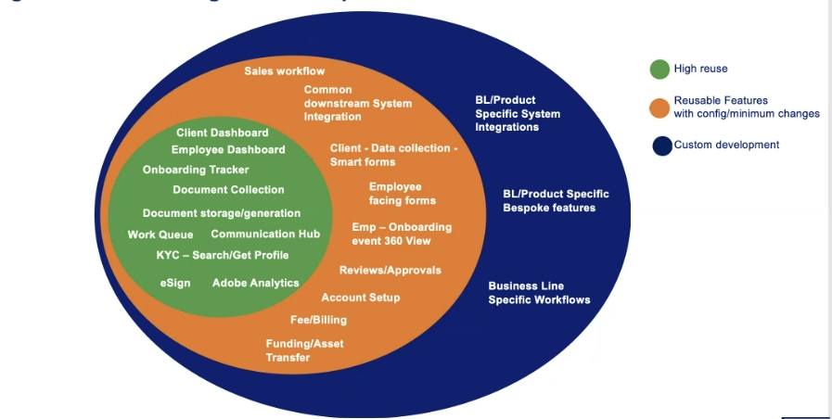
Unified Onboarding – Core Defined
Unified Onboarding CORE is the hub of a hub & spoke model approach to enable core (common) components that are configurable to a business line specific journey
Core is a combination of design/build time and runtime capabilities of unified onboarding platform as listed below
Previously all product onboarding were unique. UO would customize screens and functionality to meet business need. Moving to a CORE approach will provide more consistency between business groups.
Core is not intended to solve all onboarding requirements. Customization will be required.
Core does not have a single workflow that works for all.
The first product to be set up in CORE will be opening a DDA account
Configuration will be supported and evolve from Dev config ot user config.

Slide 22
Create new BL / Product in UO
Athena Health h
Tech Specs
Business Full Name
Business Short Name
Workflow Name (UO Baseline) [business short name.account open]
Milestone
Select Client
Select Product
Run/Verify KYC
Run/Verify IDP
Document Exchange
Sign Documents
Review/Approve Documents
Open Account
Milestone | Task | Task order
Employee User Mapping
AH OPS
Front Office

Slide 23
Create new BL / Product in UO
Product set up
SOR Product | SOR Shortname | Hogan Product | Hogan Sub Product | Name for UO
Product to Document Mapping
Name for UO | SOR Product | Client Type | Document Required | Document Type | Client e Sign
Swap | IRR Swap | Corp | ISDA |  | yes
 |  |  | W-9 |  | yes

Slide 24
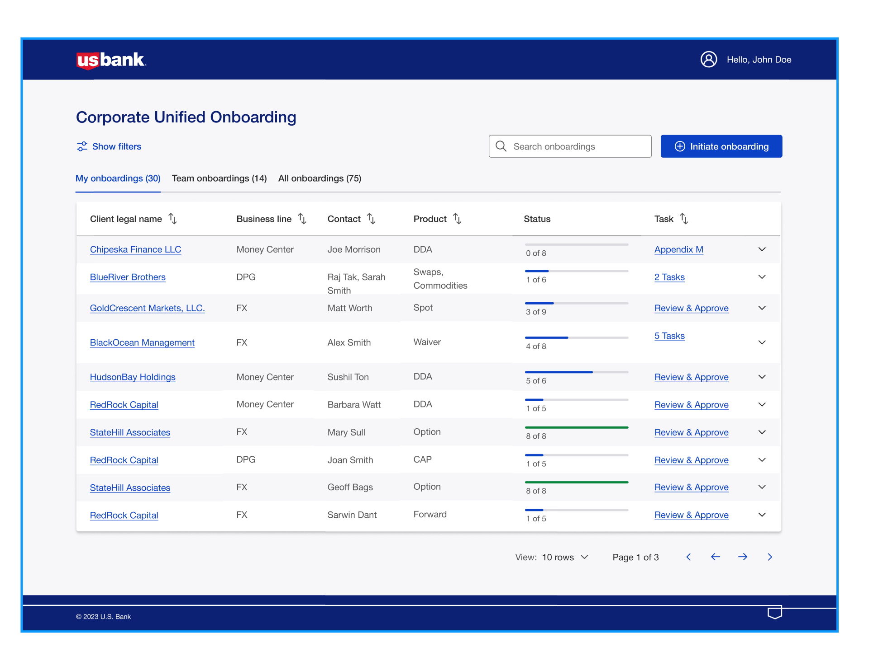
Employee Dashboard My Onboardings – ( f.k.a. Collaboration portal or Level 1)
Operations/Sales user = User Only
User has access to onboarding then “Initiate onboarding“
Listing of “my Onboardings”
Onboarding events = to created by
Click on “client legal name” to obtain Event Detail View
Click down > to expand to Milestone view
Task = current Task name
Display current tasks
Double click into tasks details
Mapping to common objects
Client Legal Name =
Business Line =
Contact =
Product =
Status=
Task=

Slide 25
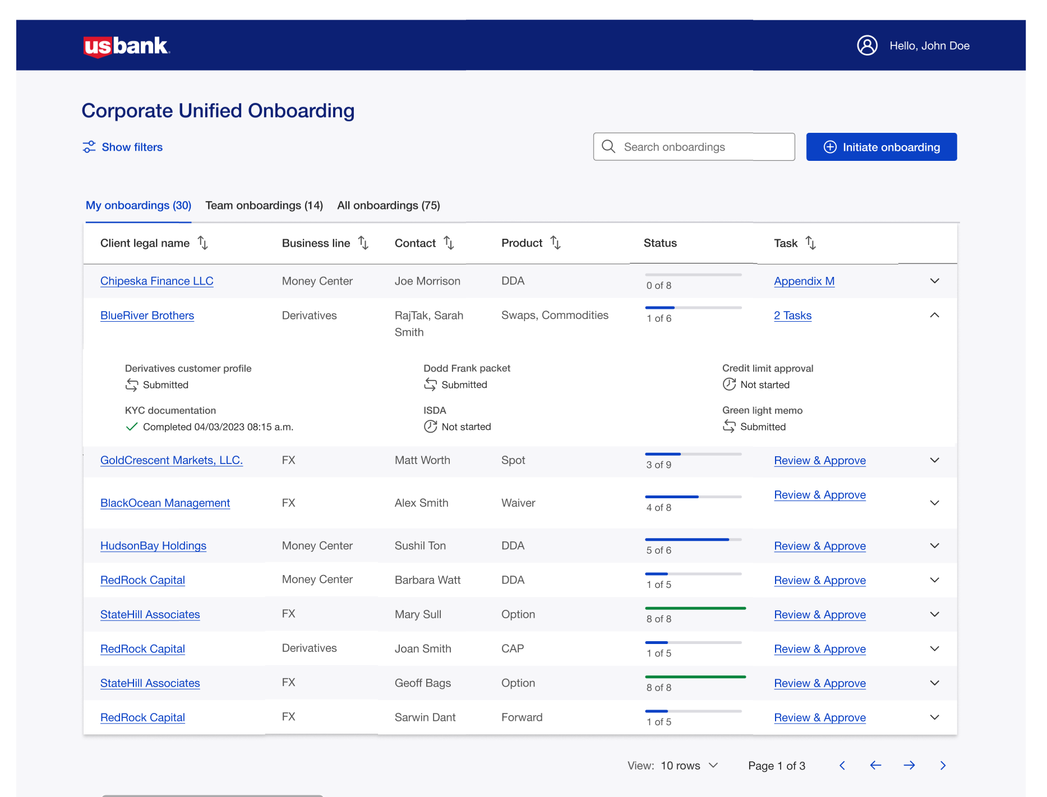
Employee Dashboard My Onboardings Expanded View – ( f.k.a. Collaboration portal or Level 1)
Operations/Sales user = User Only
User has access to onboarding then “Initiate onboarding“
Listing of “my Onboardings”
Onboarding events “user” = event. “created by”
Double click on “client legal name” to obtain Milestone View
Task = Task view
Display current tasks
Double click into tasks details
Mapping to common objects
Client Legal Name =
Business Line =
Contact =
Product =
Status=
Task=
Milestones

Slide 26
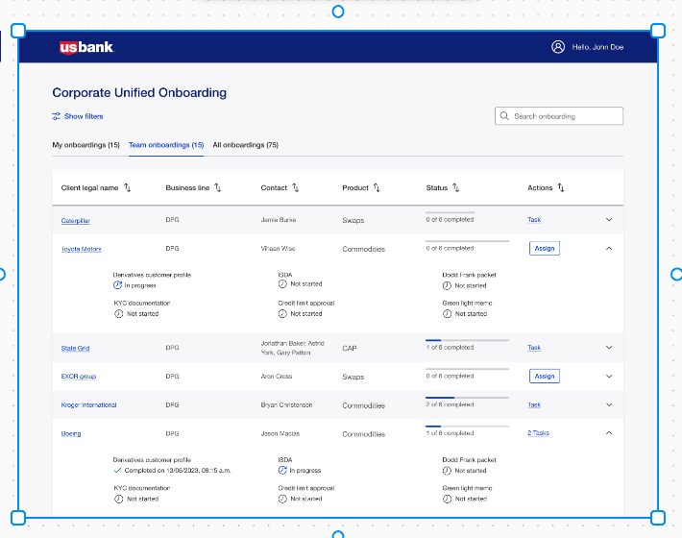
Employee Dashboard Team Onboardings – ( f.k.a. Collaboration portal or Level 1)
User mapped to team (FO, MO, BO)
Operations/Sales user (front office) = Role FO
Team who onboards customers
Team who has access to “Initiate onboarding“
Does MO and BO have same view?
Exclude “Initiate onboarding”
Listing of all team onboarding
team defined as ………
Click down > into Milestone details
Actions
Tasks - a listing or count of total tasks
Assign - ability to Assign tasks
Assign task generates email notification
Mapping to common objects
Client Legal Name =
Business Line =
Contact =
Product =
Status=
Actions=
Milestones =

Slide 27
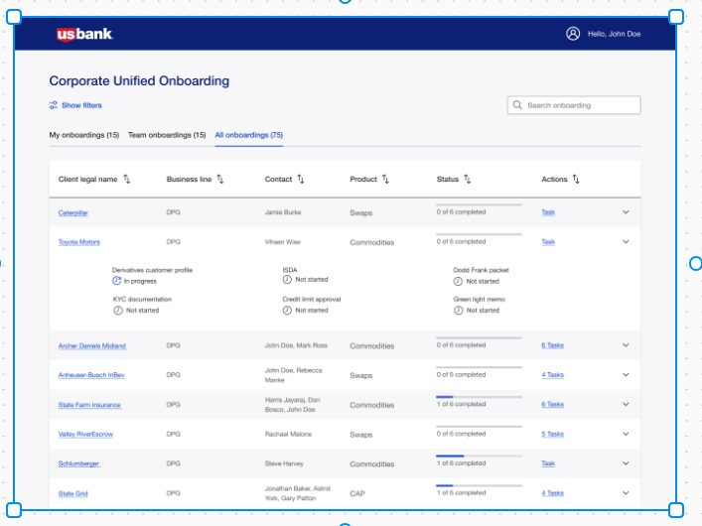
Employee Dashboard All Onboardings – ( f.k.a. Collaboration portal or Level 1)
User mapped to team (FO, MO, BO)
Operations/Sales user (front office) = Role FO
All onboarding for BL group“
Does MO and BO have same view?
Listing of all team onboarding
team defined as ………
Click down > into Milestone
Assign tasks
Mapping to common objects
Client Legal Name =
Business Line =
Contact =
Product =
Status=
Task=
Milestones =

Slide 29
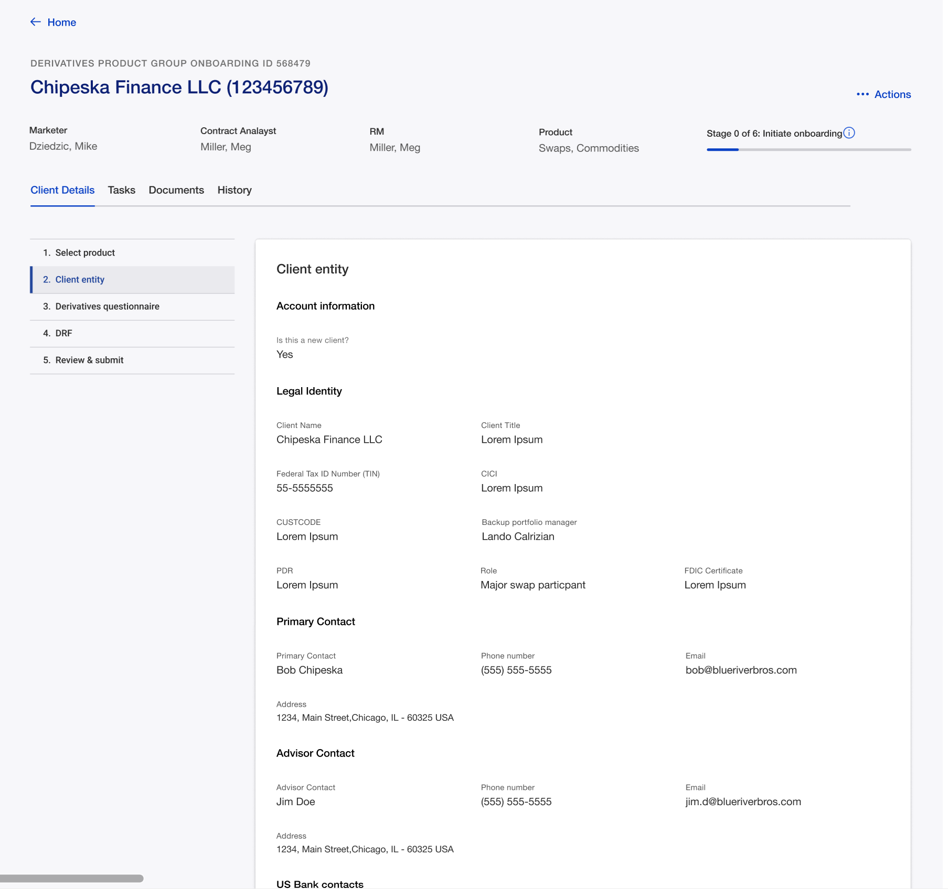
Account Detail – Level 2
UX Add Tab
Customer access
Client Entity
Update to a standard view
Hogan Info
KYC Info
D&B Info
Entity Legal Hierarchy
RPMS Hierarchy
Map to common Objects
Client
Packet sent
Recipient
Relationship Manager
MC Rep
Tasks
Task Status
Assigned to
Last Updated
Updated by
Map to common Objects
Client
Packet sent
Recipient
Relationship Manager
MC Rep
Tasks
Task Status
Assigned to
Last Updated
Updated by

Slide 30
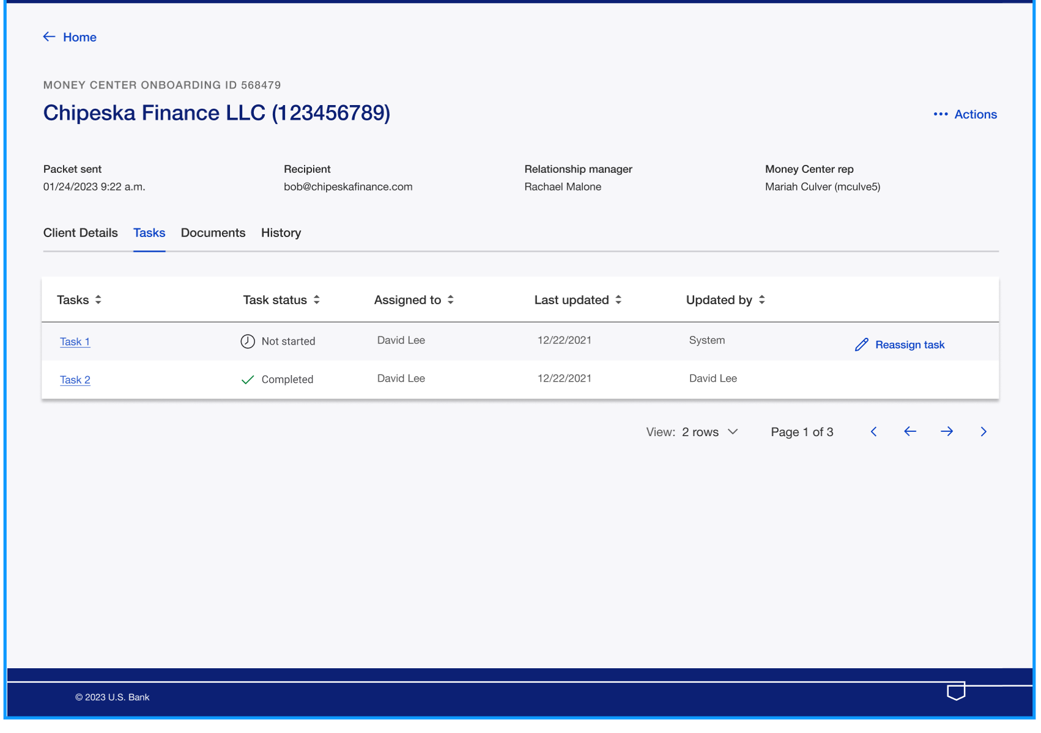
Tasks
UX Design
Add tasks order
Add task Milestones
Change Money Center Rep
Map to common Objects
Client
Packet sent
Recipient
Relationship Manager
MC Rep
Tasks
Task Status
Assigned to
Last Updated
Updated by

Slide 31
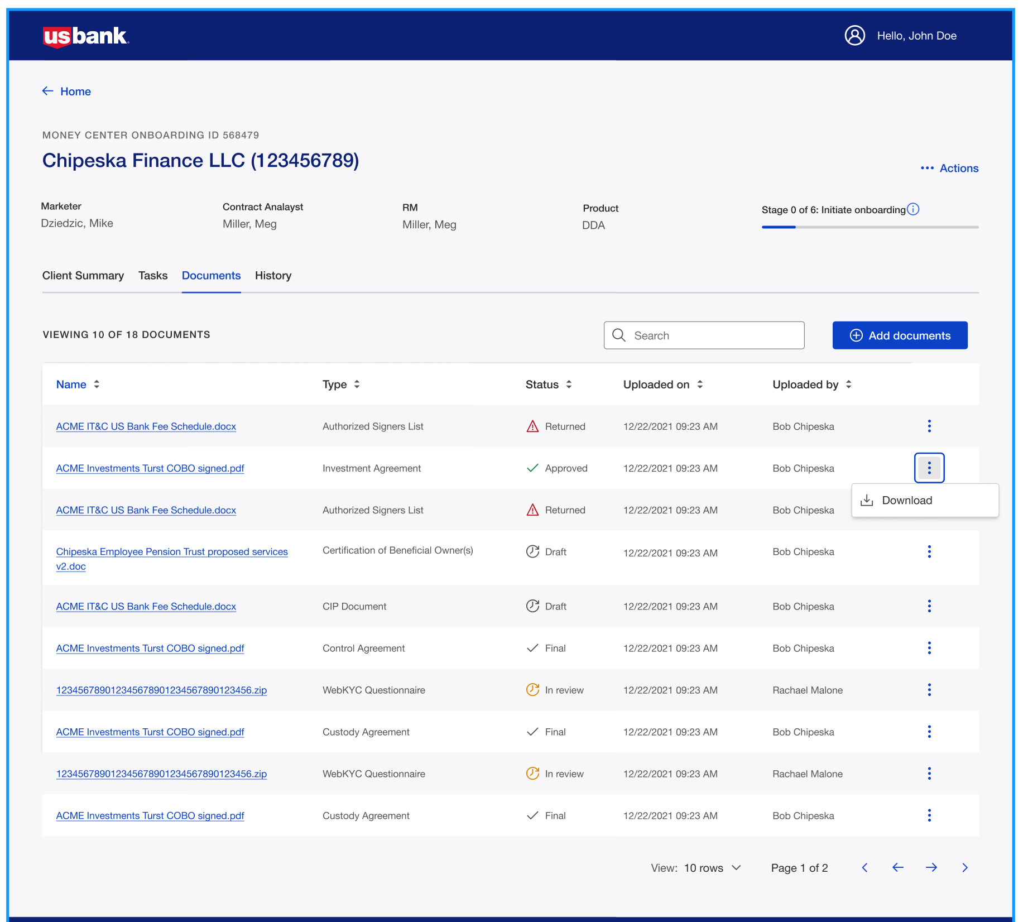
Documents
UX
Should contain the complete set of document required by product by client type
CORE MVP
Documents will be created outside the systems and loaded into the system. Documents can be flagged for signature
Documents have a mini workflow. Based on product to document mapping

Slide 32
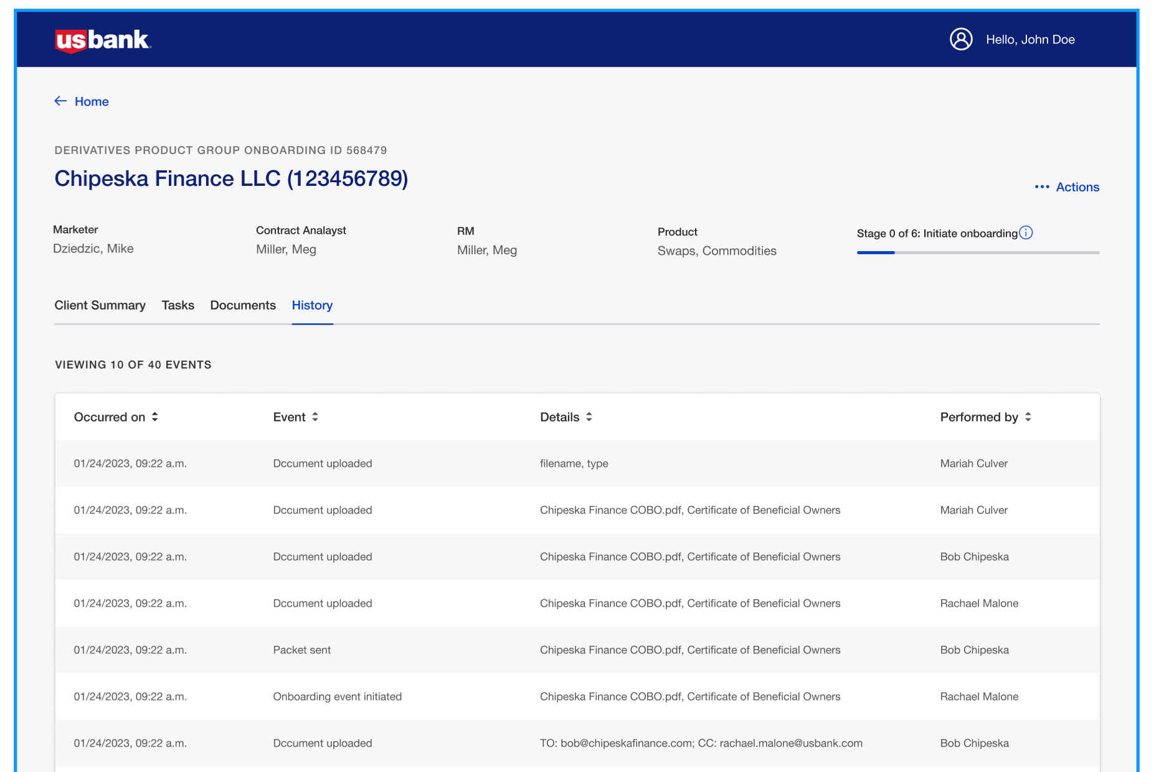
History
UX
Mapping to Common Objects

Slide 33
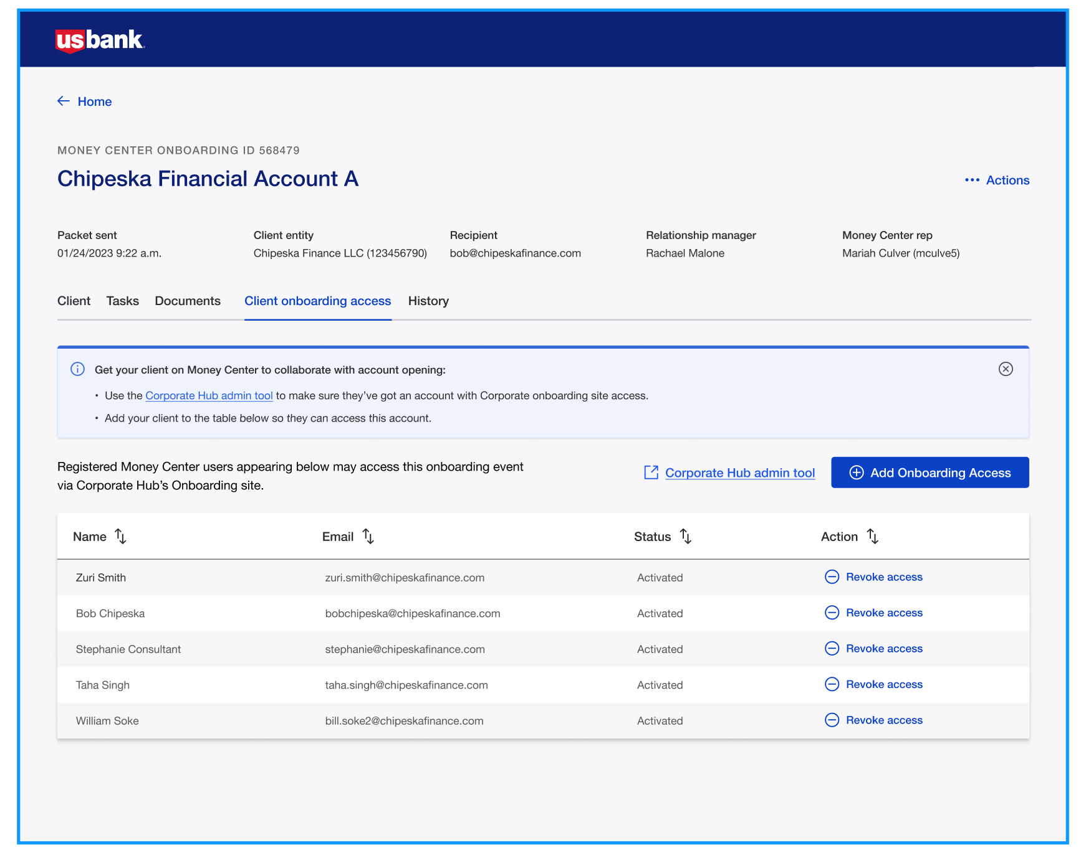
Client Access
UX
Users
Mapping to Common Objects

Slide 34

Collaboration Portal Dashboard
Employee Dashboard
UX – Client/employee collaboration
Configurability
Centralized rule engine
Workflow Engine
User role/privileges
Segment/Product workflows
Global Jurisdictional
Periodic/on-demand reviews
Transaction monitoring
Auditability
Now –
Ability for employees to have visibility into the onboarding events
Flexibility to configure dashboard view based on the Role/BL
Ability to search/filter/sort onboarding records
Usage – Money Center, DPG,FX, FBO, GCT, PT, IT&C, FX
Roadmap – Common object model to bring consistency across BLs
Level of reuse – High
Type of reuse – Plug and play

Slide 35
Employee Dashboard
Employee Dashboard
UX – Client/employee collaboration
Configurability
Centralized rule engine
Workflow Engine
User role/privileges
Segment/Product workflows
Global Jurisdictional
Periodic/on-demand reviews
Transaction monitoring
Auditability
Now –
Ability for employees to have visibility into the onboarding events
Flexibility to configure dashboard view based on the Role/BL
Ability to search/filter/sort onboarding records
Usage – Money Center, DPG,FX, FBO, GCT, PT, IT&C, FX
Roadmap – Common object model to bring consistency across BLs
Level of reuse – High
Type of reuse – Plug and play

Slide 36
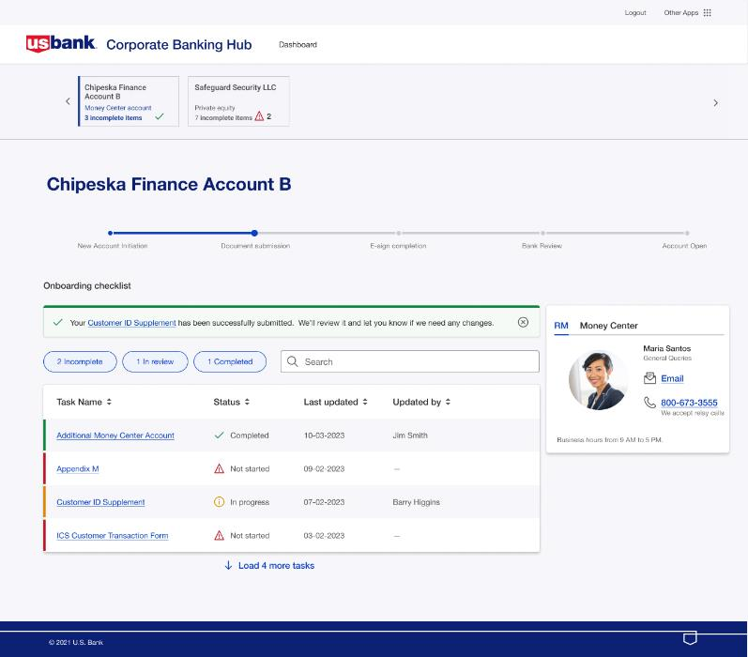
Client Experience – Onboarding Tracker
Client Onboarding Tracker
UX – Client/employee collaboration
Configurability
Centralized rule engine
Workflow Engine
User role/privileges
Segment/Product workflows
Global Jurisdictional
Periodic/on-demand reviews
Transaction monitoring
Auditability
Now –
Ability for clients to have visibility into the onboarding process
Onboarding milestone tracker
Task list, U.S. Bank Contacts
SSO from systems of engagements e.g. Pivot
Usage – IT&C, GFS, Money Center
Roadmap –
Integration with Corporate Hub – SSO and task list
Level of reuse – High
Type of reuse – Plug and play

Slide 37
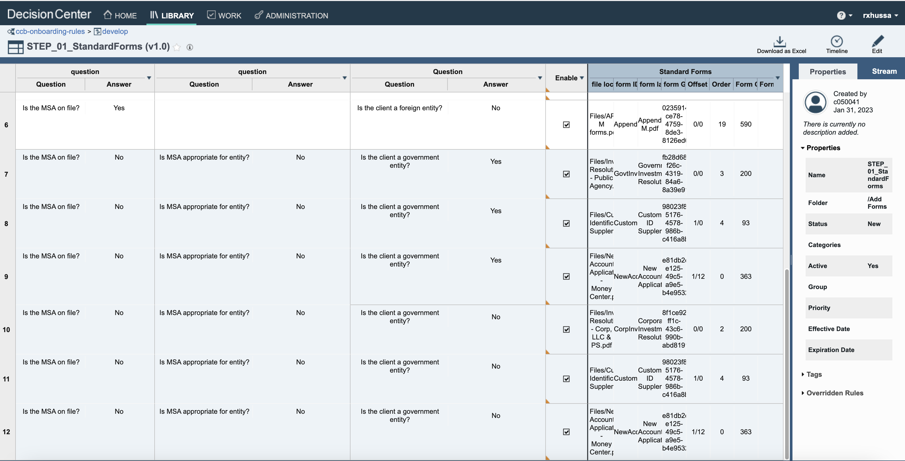
Business Rules Engine
Centralized Rule Engine
Now –
Ability for non-technical users to write business rules
Enterprise grade rule engine, supports complex decision implementation
Built in testing/simulation and governance features
Role based permission management
Auditability
Usage – GFS, IT&C, GCT, PT, Money Center
1000+ rules for onboarding use case
Roadmap –
Level of reuse – High
Type of reuse – It’s a plug and play tool to write new business rules

Slide 38
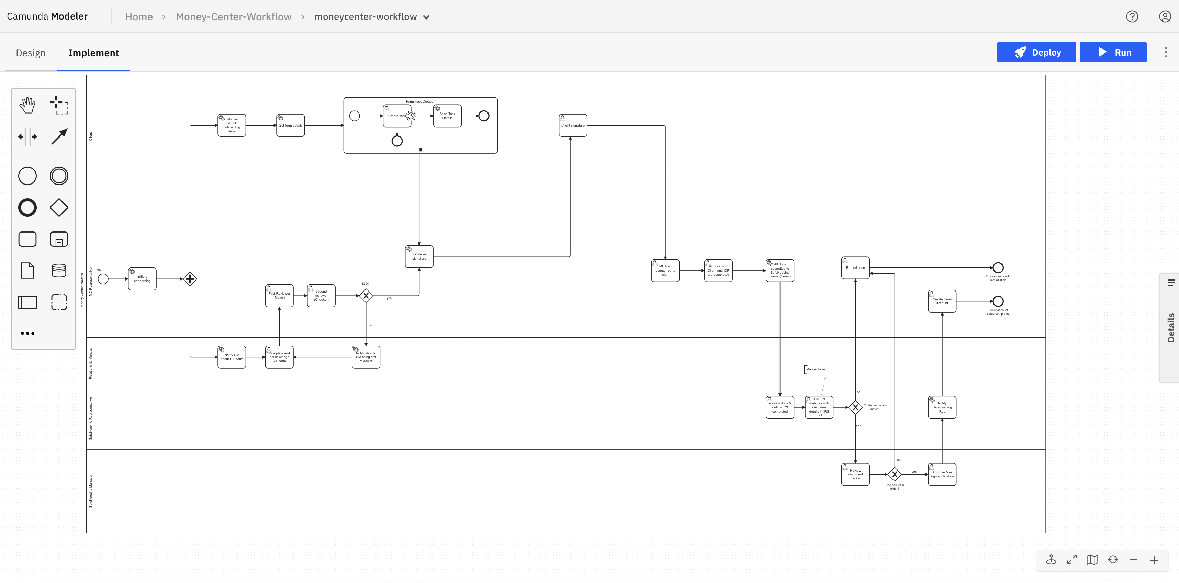
Drag and Drop Workflow
Unified Onboarding Product Examples
Centralized Workflow Engine
Now –
Ability to create onboarding journeys using a web modeler
Automate complex process flows across people and systems.
Supports BPMN 2.0 specification – human activity, system activity, Integrations
Flexible architecture to support API integration into any solution
Usage – GFS, IT&C, GCT, PT, Money Center, FBO, DPG, FX
Roadmap –
Level of reuse – High
Type of reuse – Plug and play workflow tool to create new

Slide 39
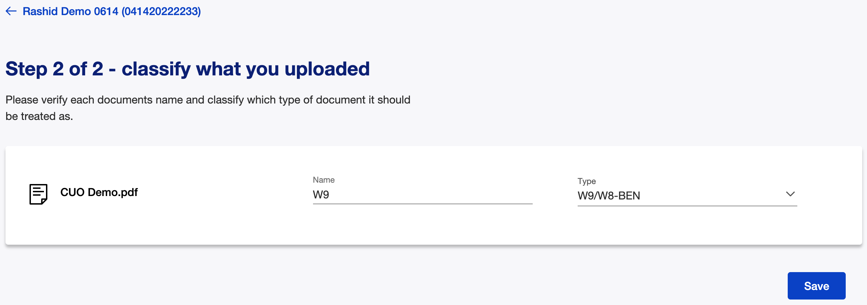
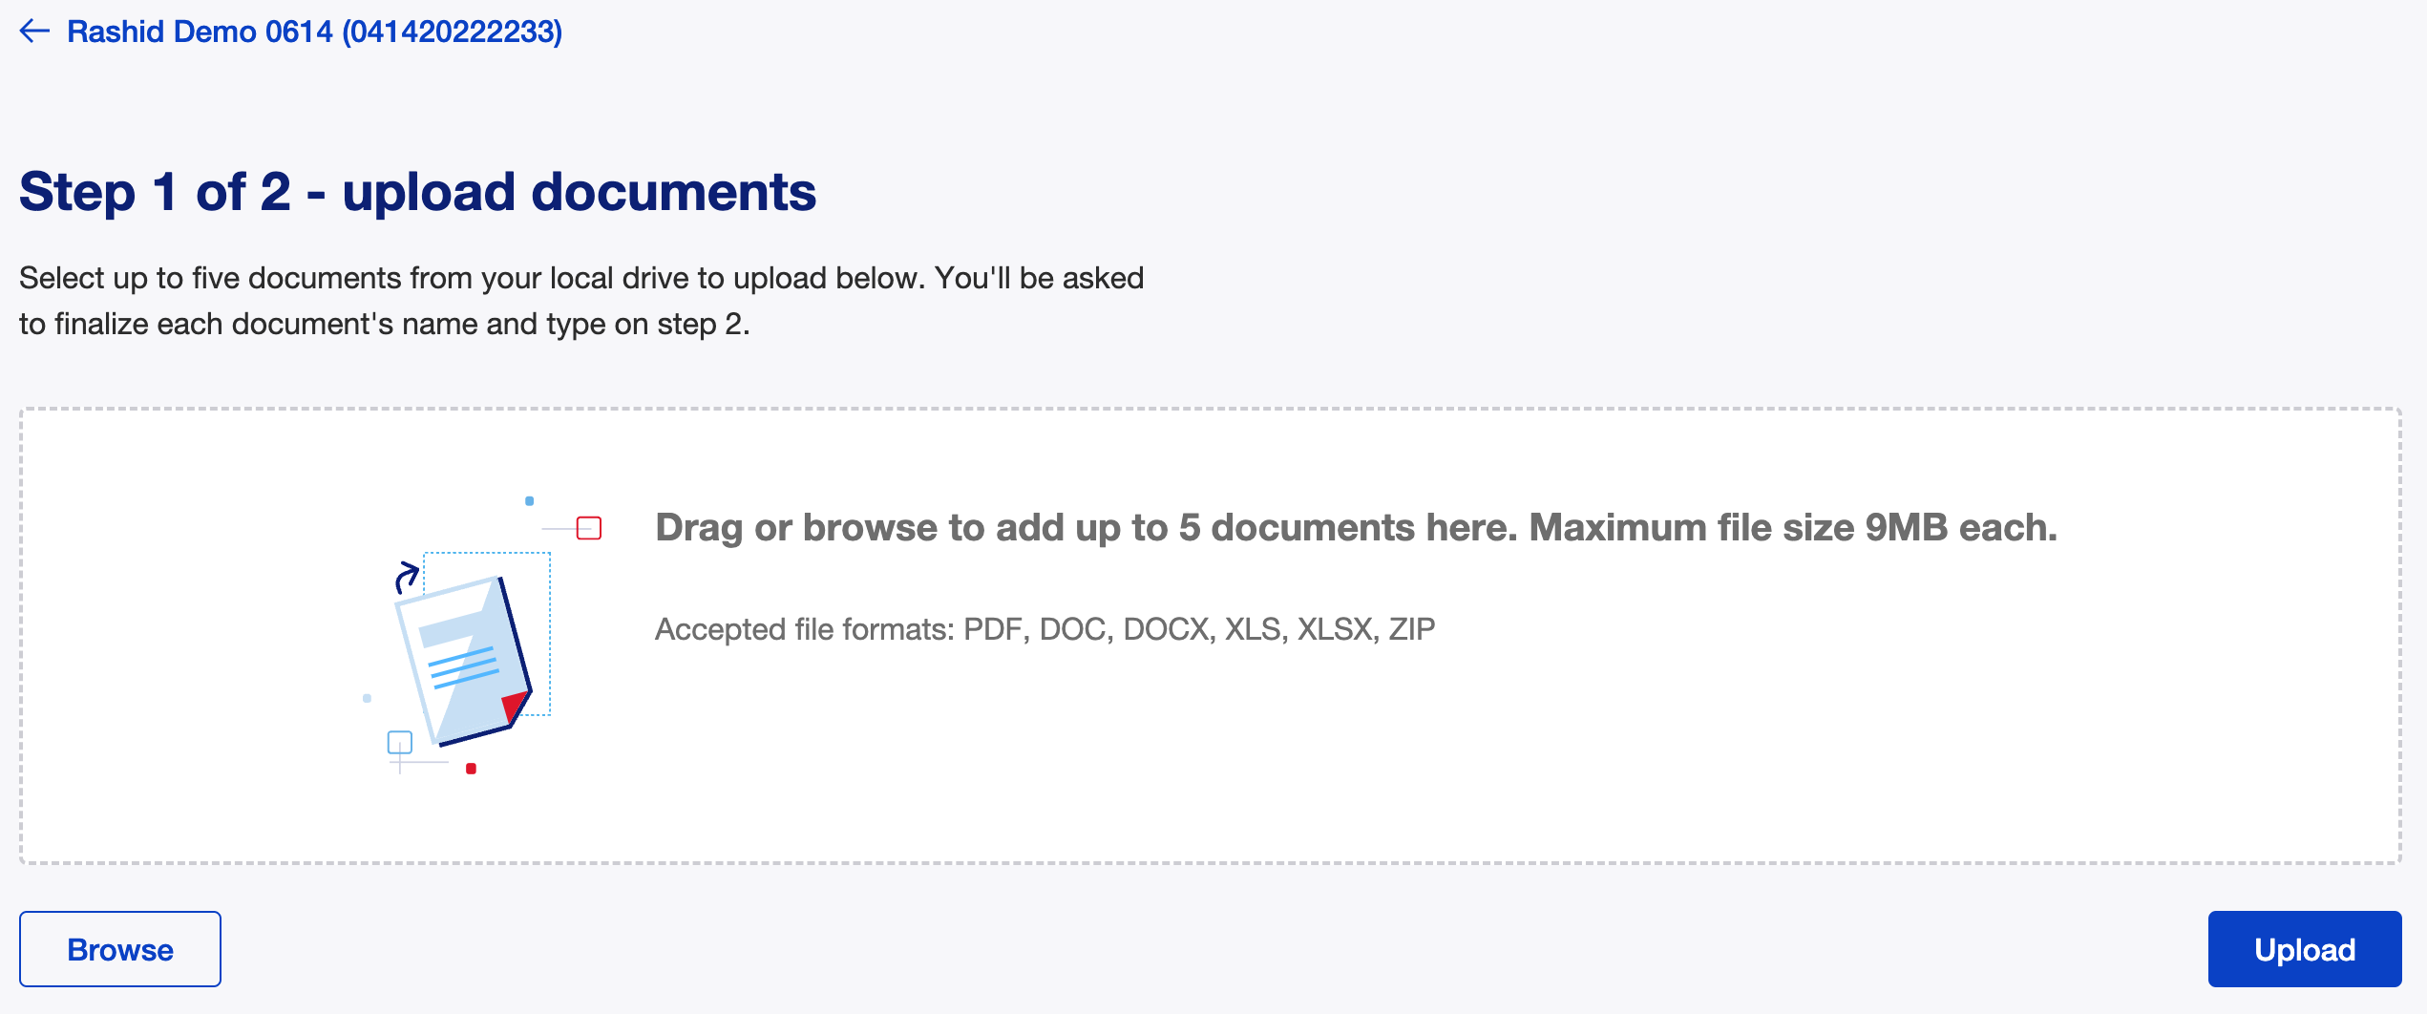
Document Management
Document Management
Now –
Ability to upload/download documents for employee/client persona
Configurable APIs to support multiple FileNet Doc Classes for various BLs
Ability for employee/client to collaborate for document collection/review/approvals
Usage – GFS, IT&C, GCT, PT, Money Center, FX
Roadmap –
Integrate with CMOD doc repository for DPG use case
Level of reuse – High
Type of reuse – Plug and play

Slide 40
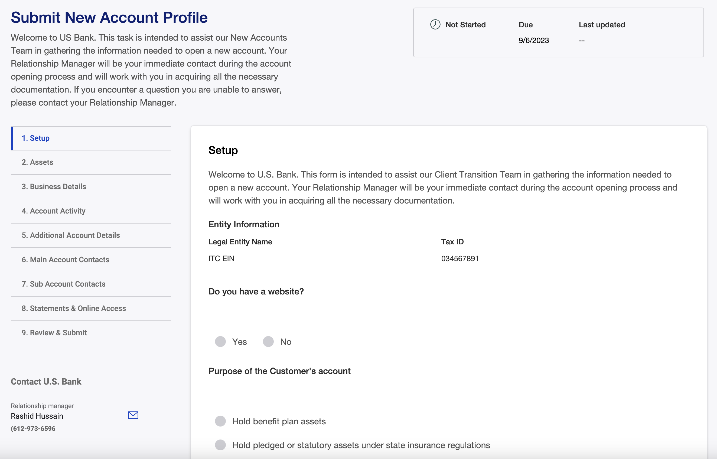
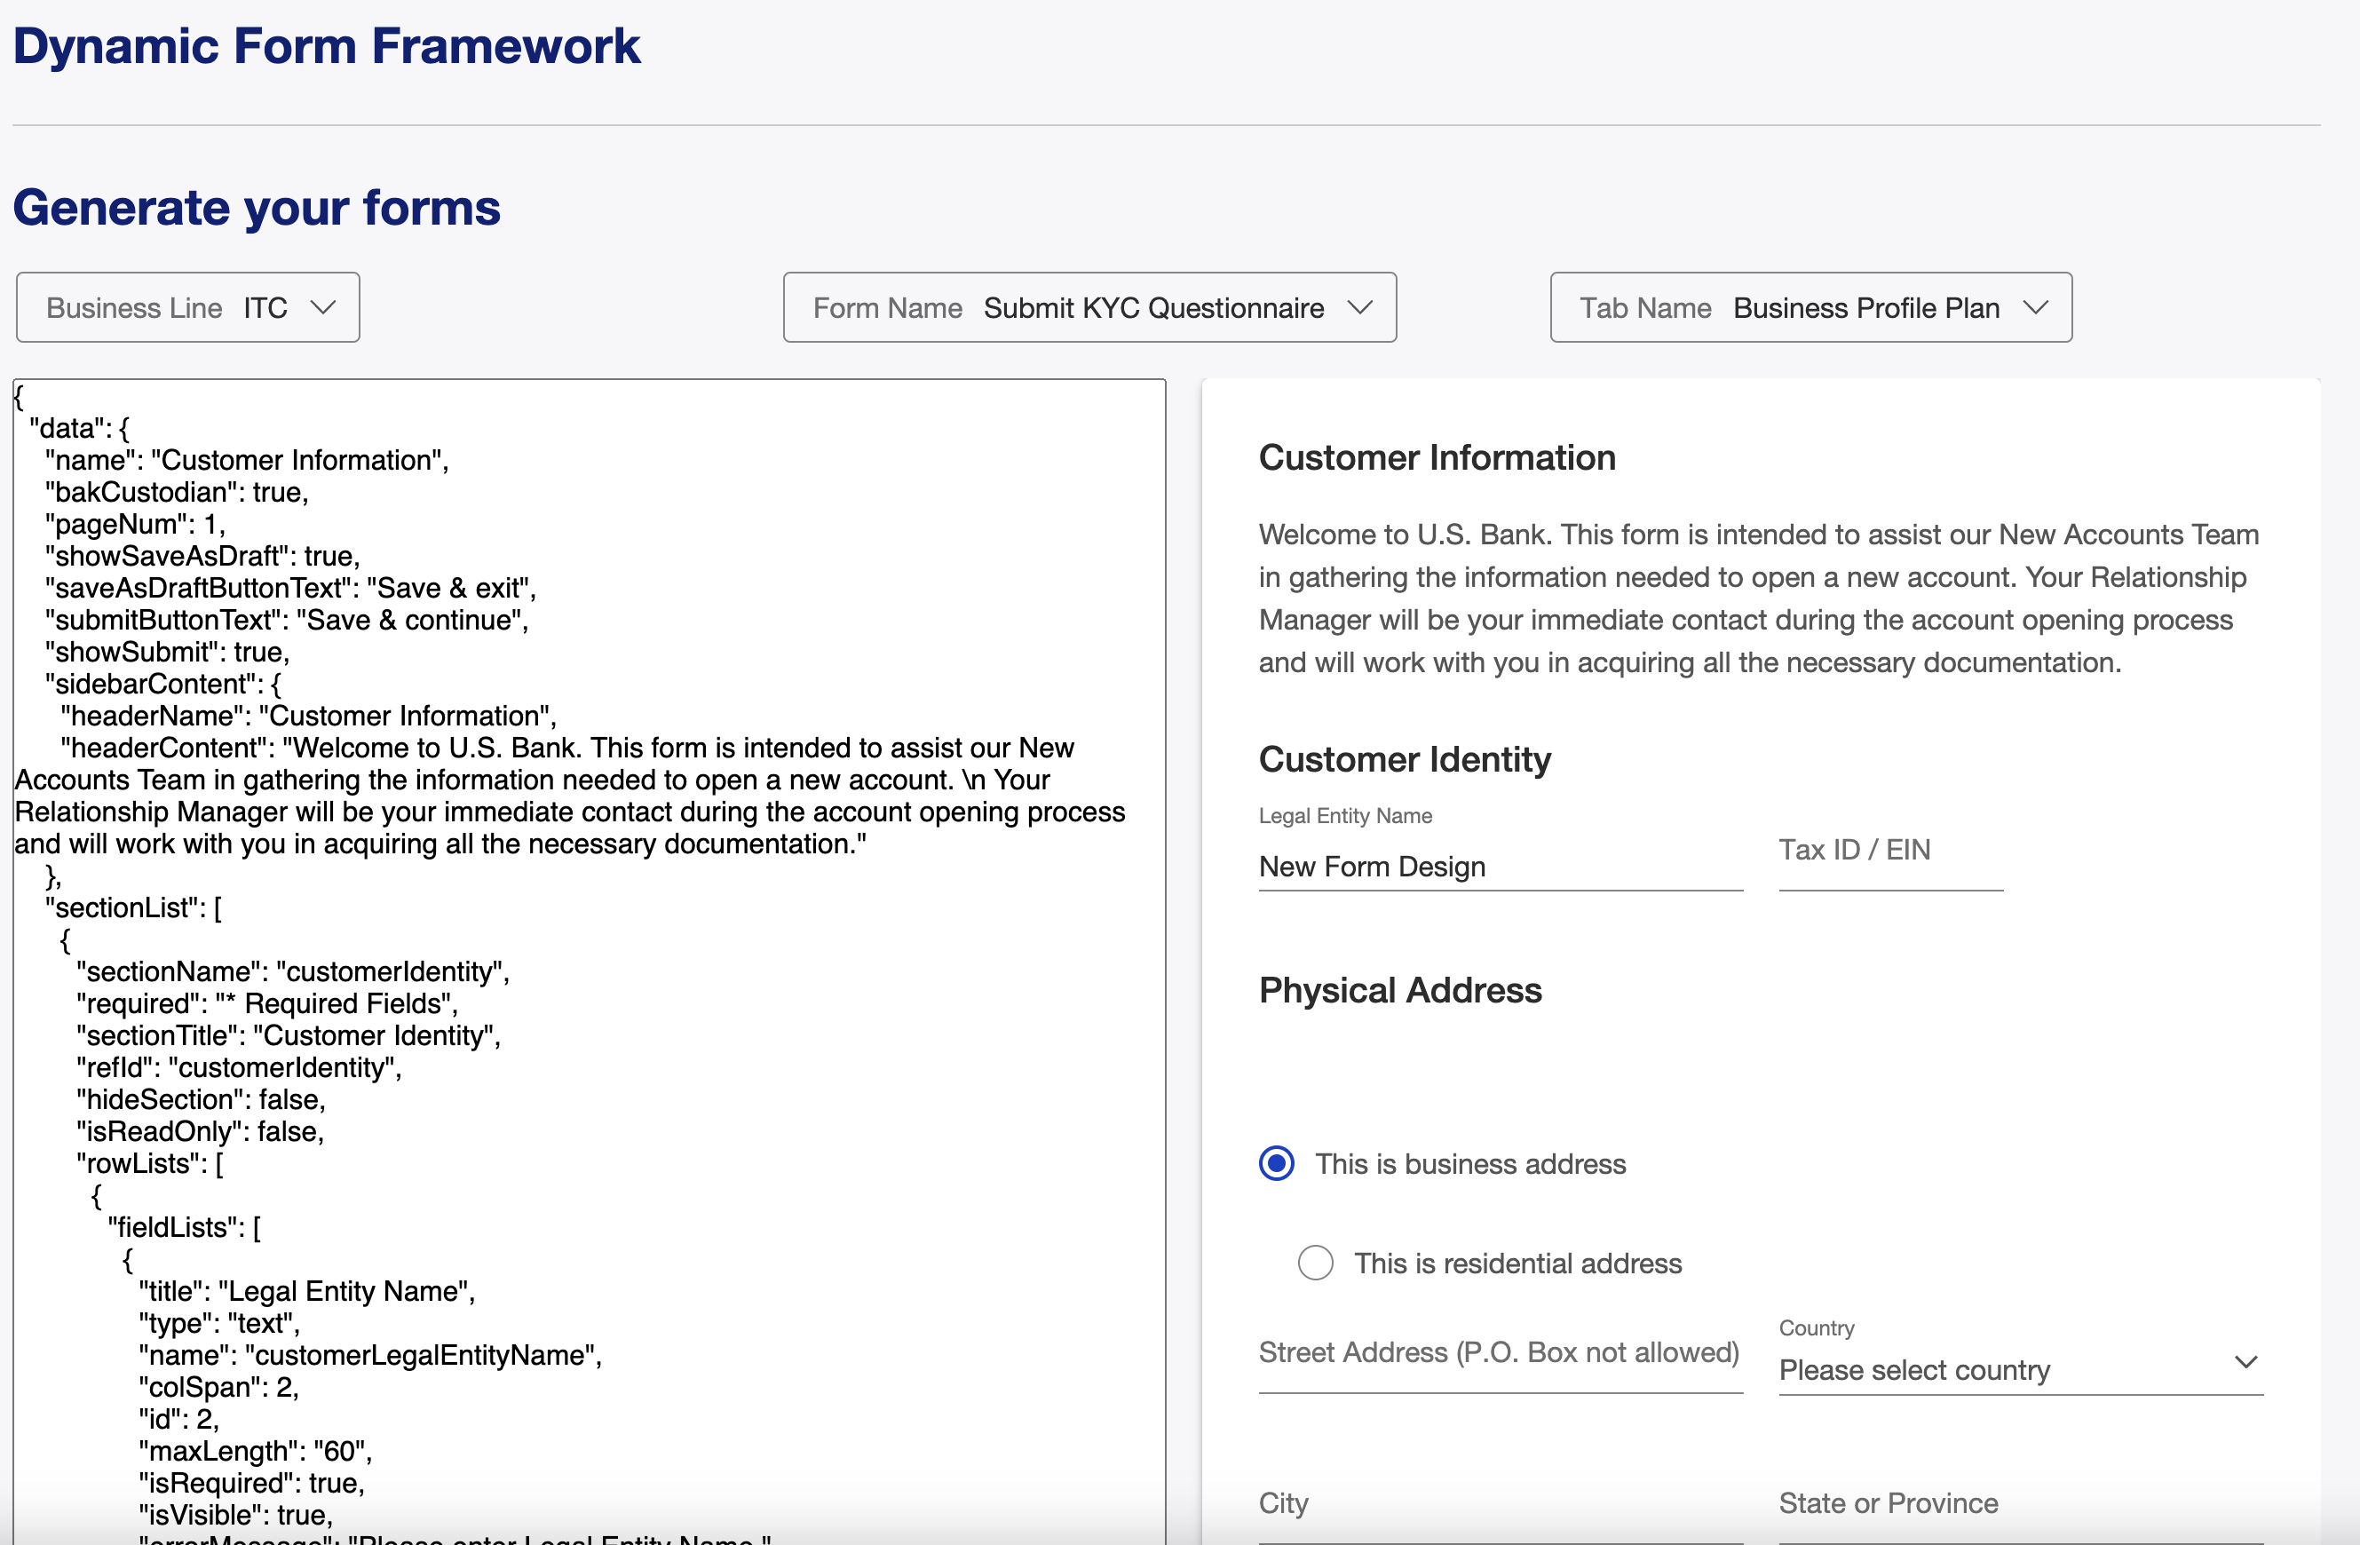
Dynamic Forms for Data Capture (Smart forms)
Dynamic Form Framework
Now –
Ability to build React based UI forms using Json metadata
Can handle varying degree of complexity to address the needs of corporate segment
Key features- Validations, error messages, simple fields, complex nested cards, tables, conditional logic, data binding, API calls, save in-progress form context
Usage – GFS, IT&C, GCT, PT, Money Center, FBO, DPG, FX
35+ distinct forms consisting of 200+ pages
Roadmap –
Form preview – inline JSON editor, Field level annotation, nested card support,
Level of reuse – High
Type of reuse – It’s a plug and play tool to build forms

Slide 41
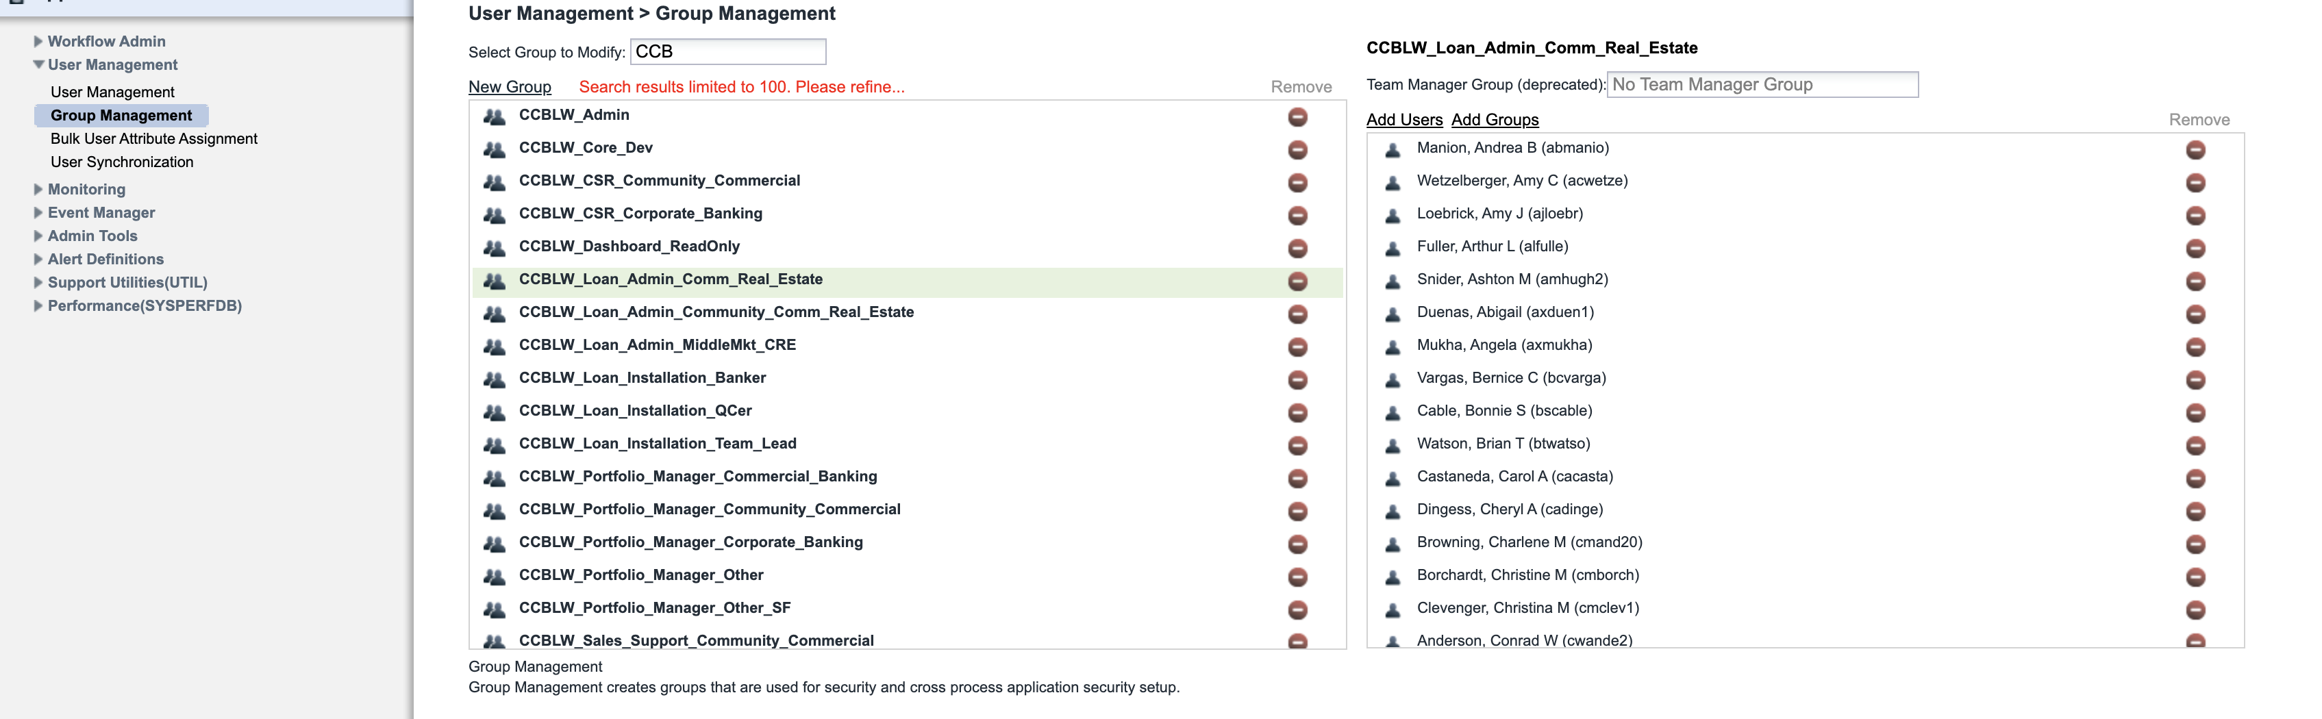
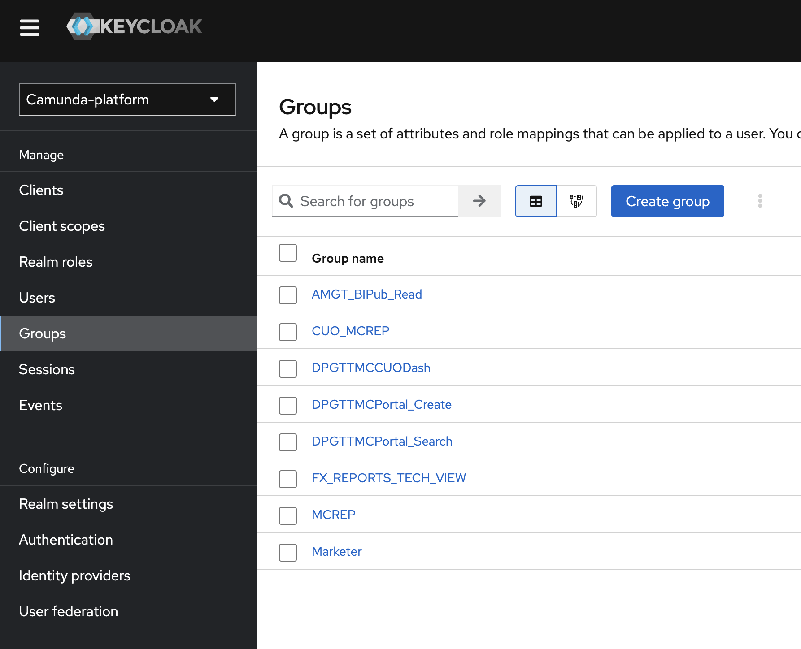
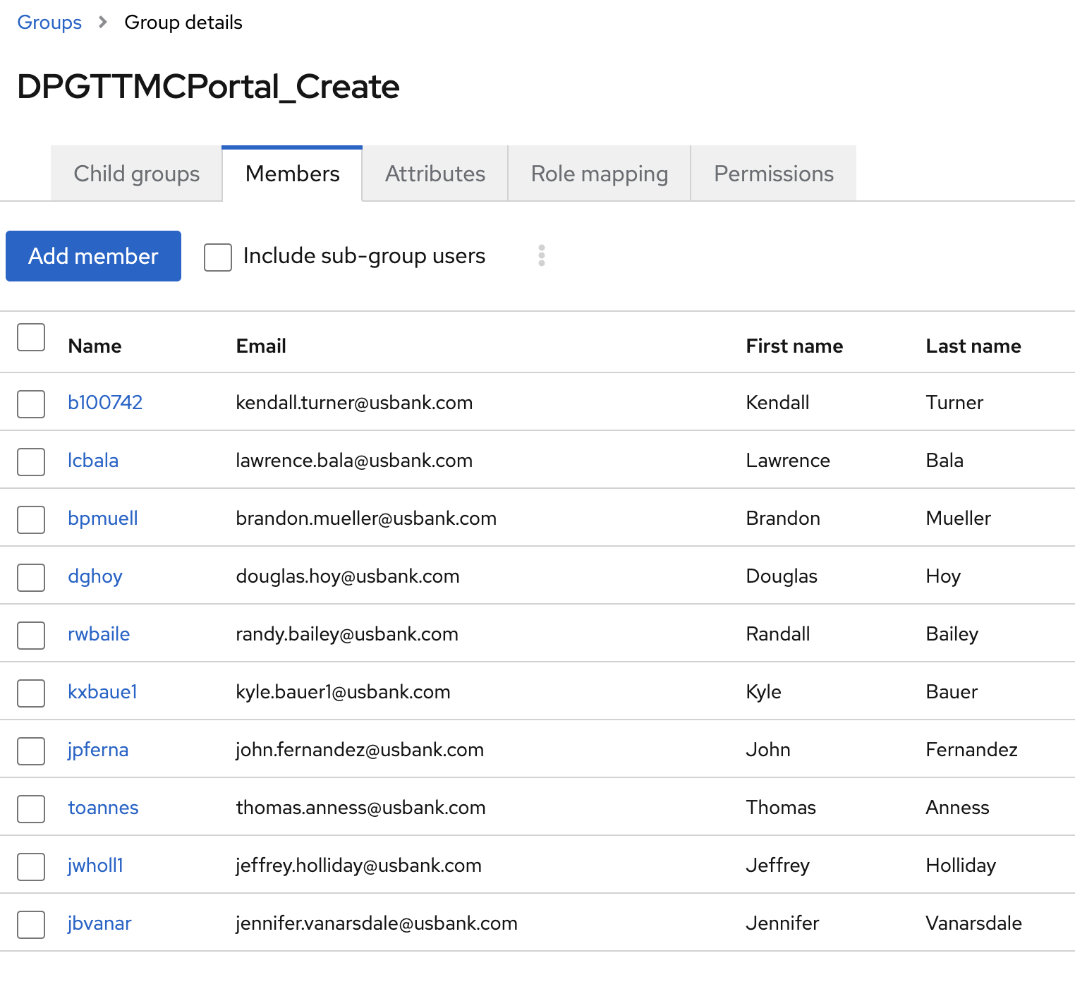
User Provisioning
User Provisioning, Roles/Privileges
Now –
Ability to provision client users for onboarding events
Employee user provisioning- Windows authentication based SSO, leverage LDAP groups/access management for role access
Usage – Money Center, DPG,FX, FBO, GCT, PT, IT&C, FX
Roadmap –
Enable user provisioning for SinglePoint OU for Money Center use case
Ability to search existing SinglePoint OU users from onboarding
Level of reuse – High
Type of reuse – Plug and play

Slide 42
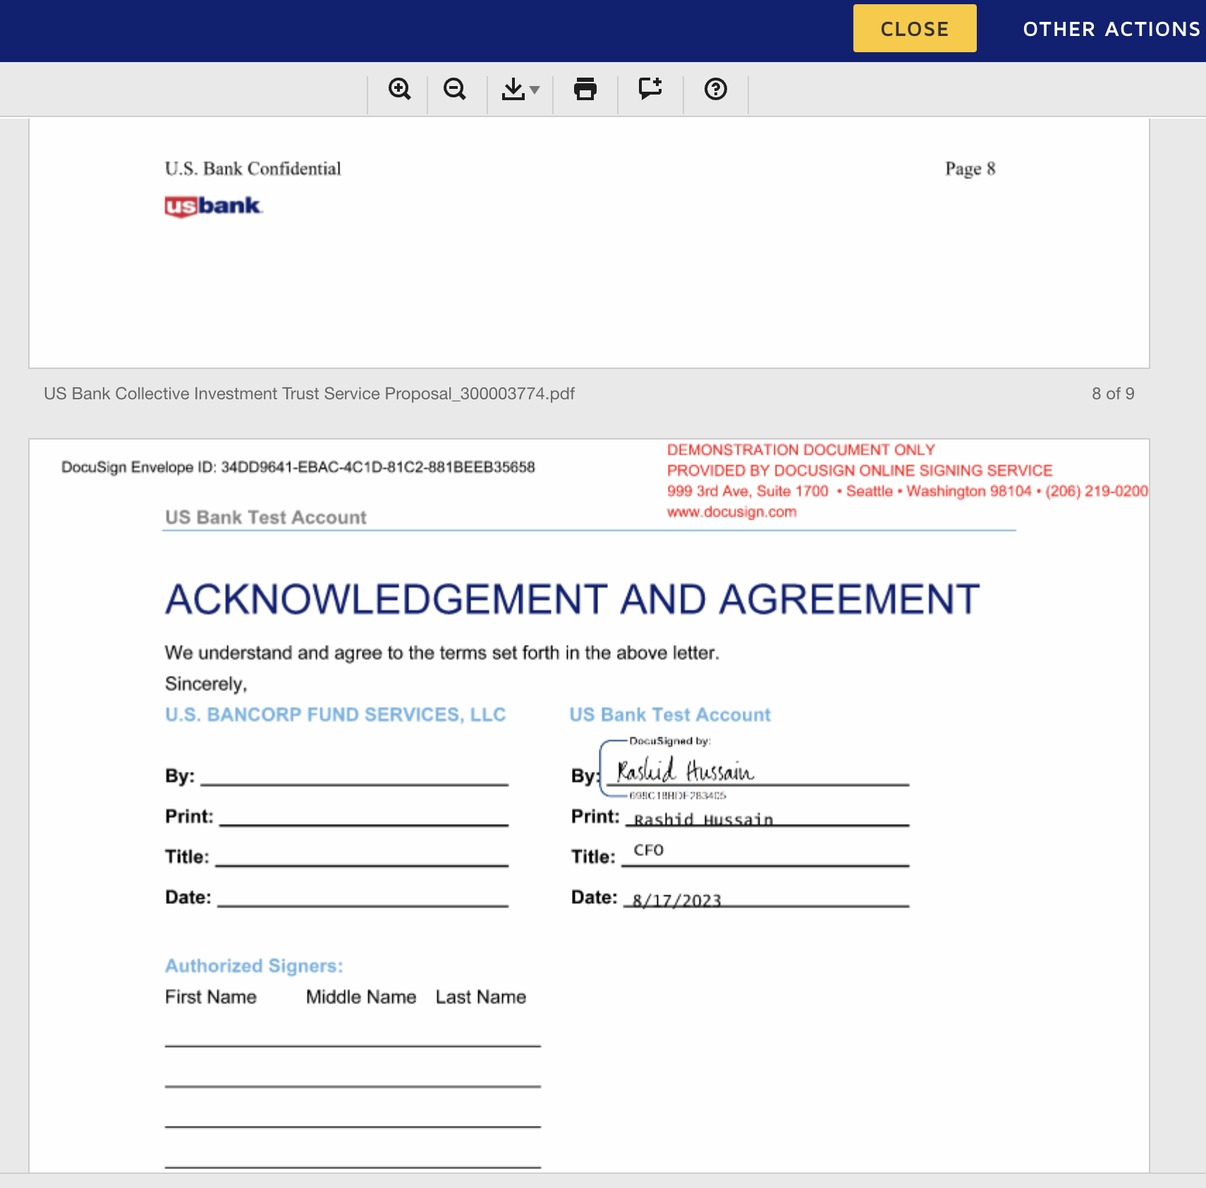
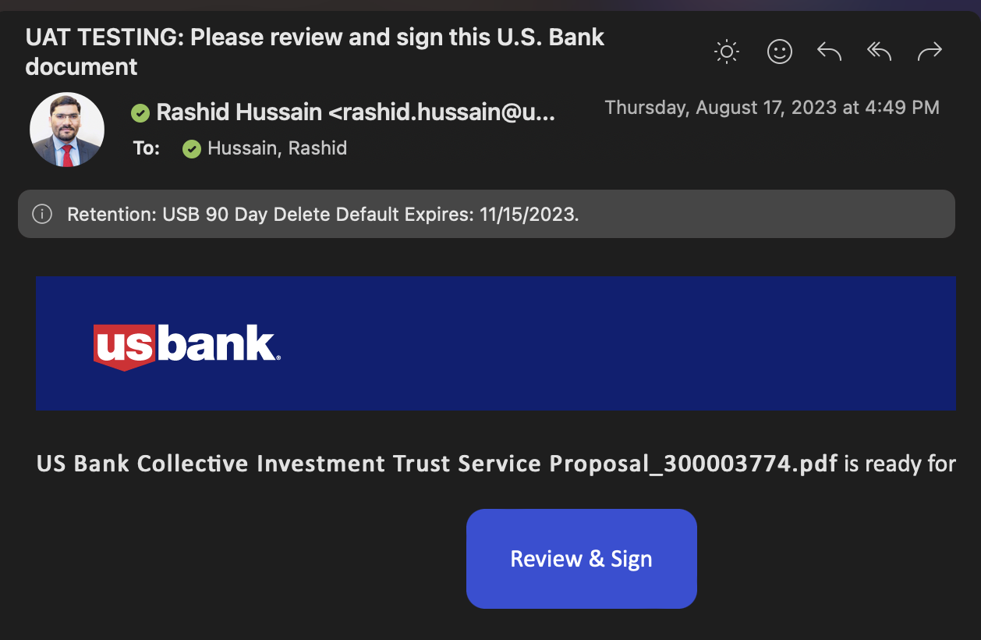
eSign
eSign Integration (DocuSign/OneSpan)
Now –
Ability to initiate eSign for clients/employees using DocuSign
Orchestrate multi-signer flow
Store signed docs in FileNet
Usage – GFS
Roadmap –
Enable eSigning capabilities using OneSpan cloud – development in progress
Level of reuse – High
Type of reuse – Plug and play

Slide 43
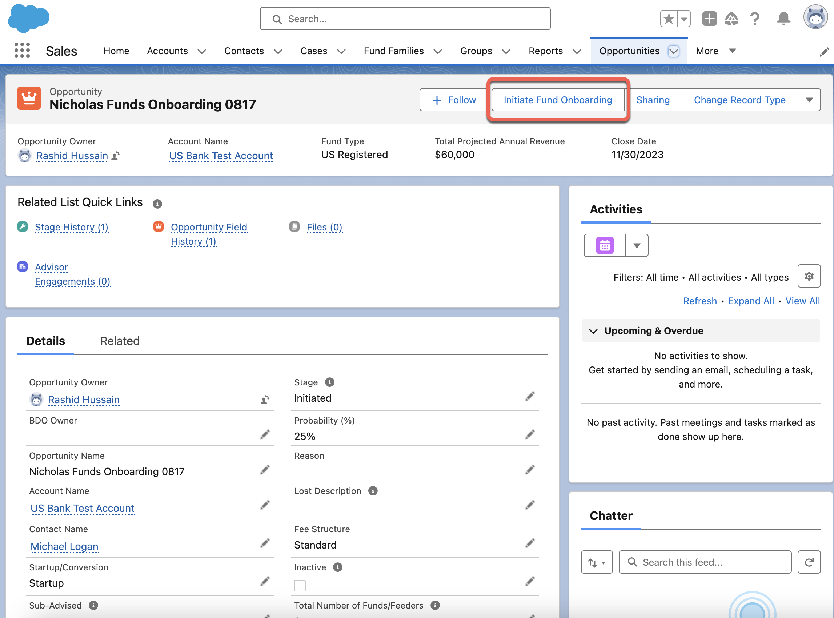
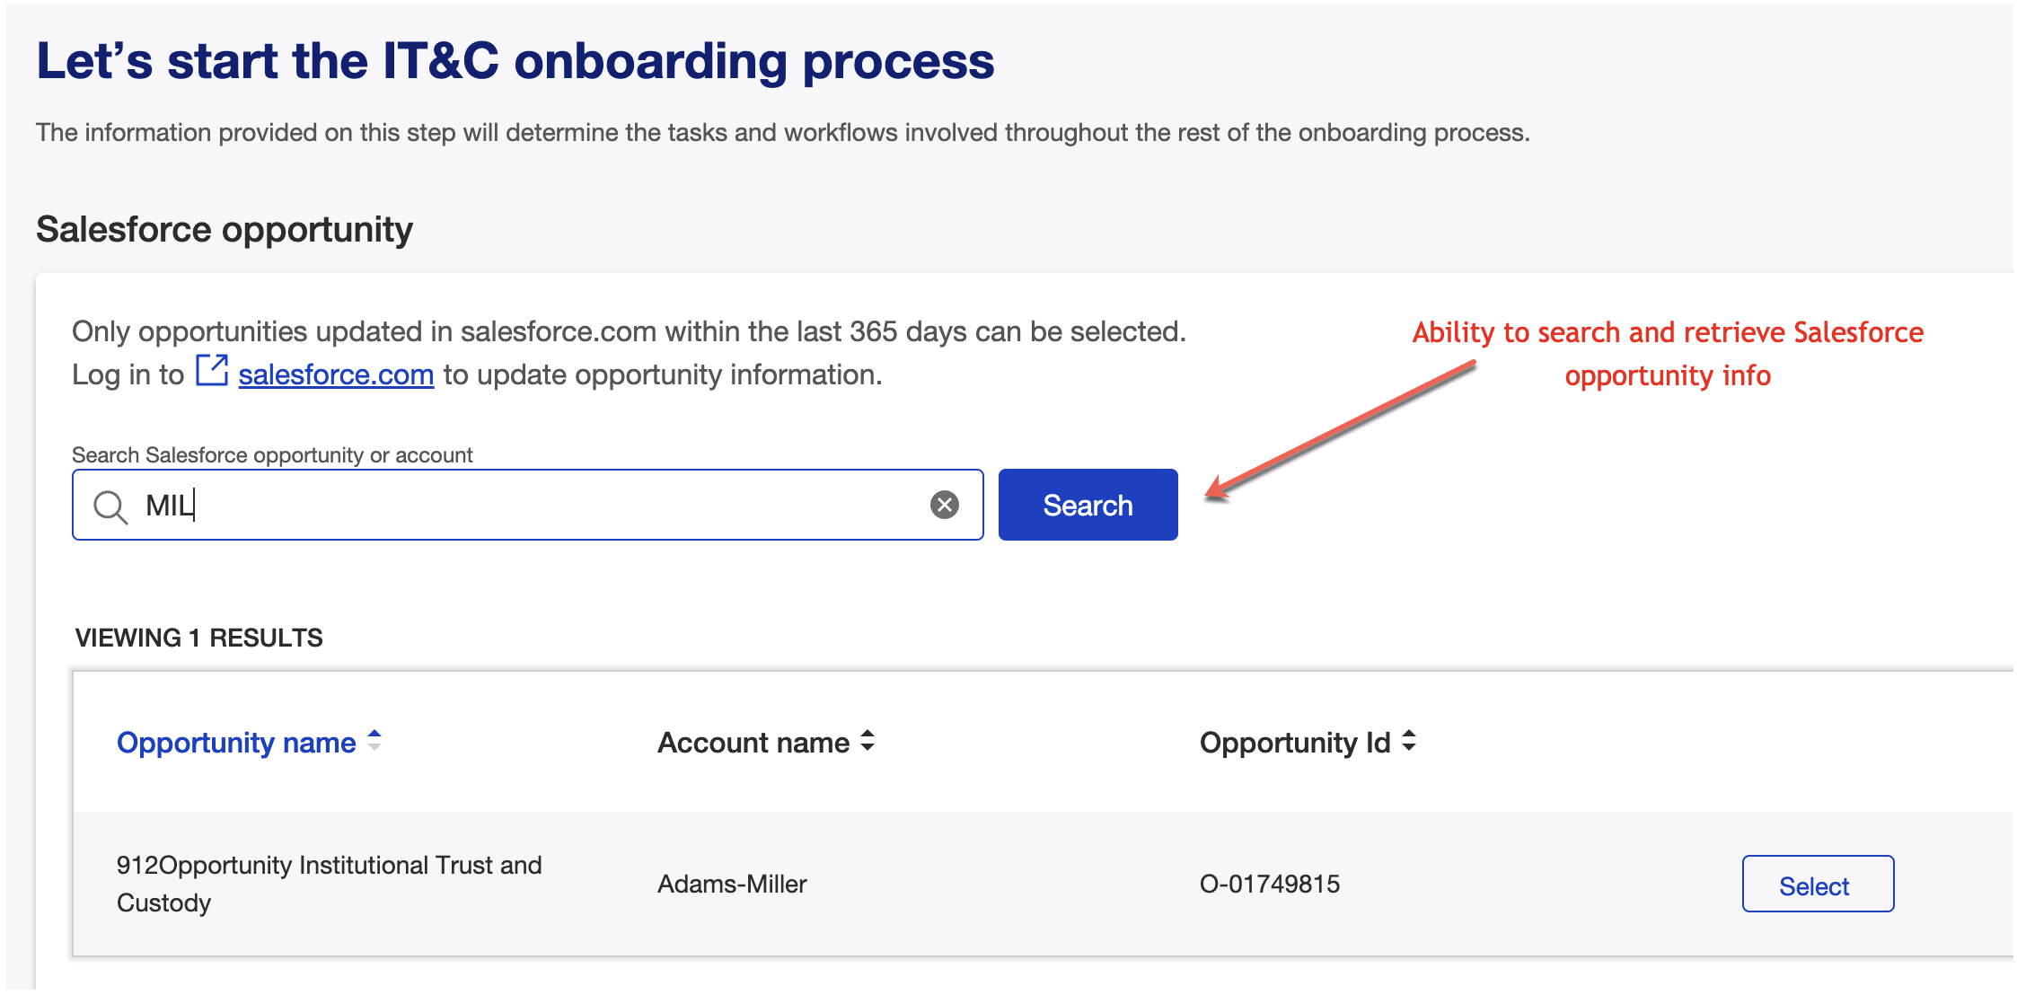
Salesforce Integration
CRM(Salesforce) Integration
Now –
Ability to push and pull salesforce opportunity data.
Avoid manual re-key in of the CRM data into onboarding platform
Usage – GFS, IT&C, GCT, PT
Roadmap – Real time data pull for Personal Trust instance
Push additional data for GFS opportunity
Level of reuse – High
Type of reuse – Reuse with coding

Slide 44

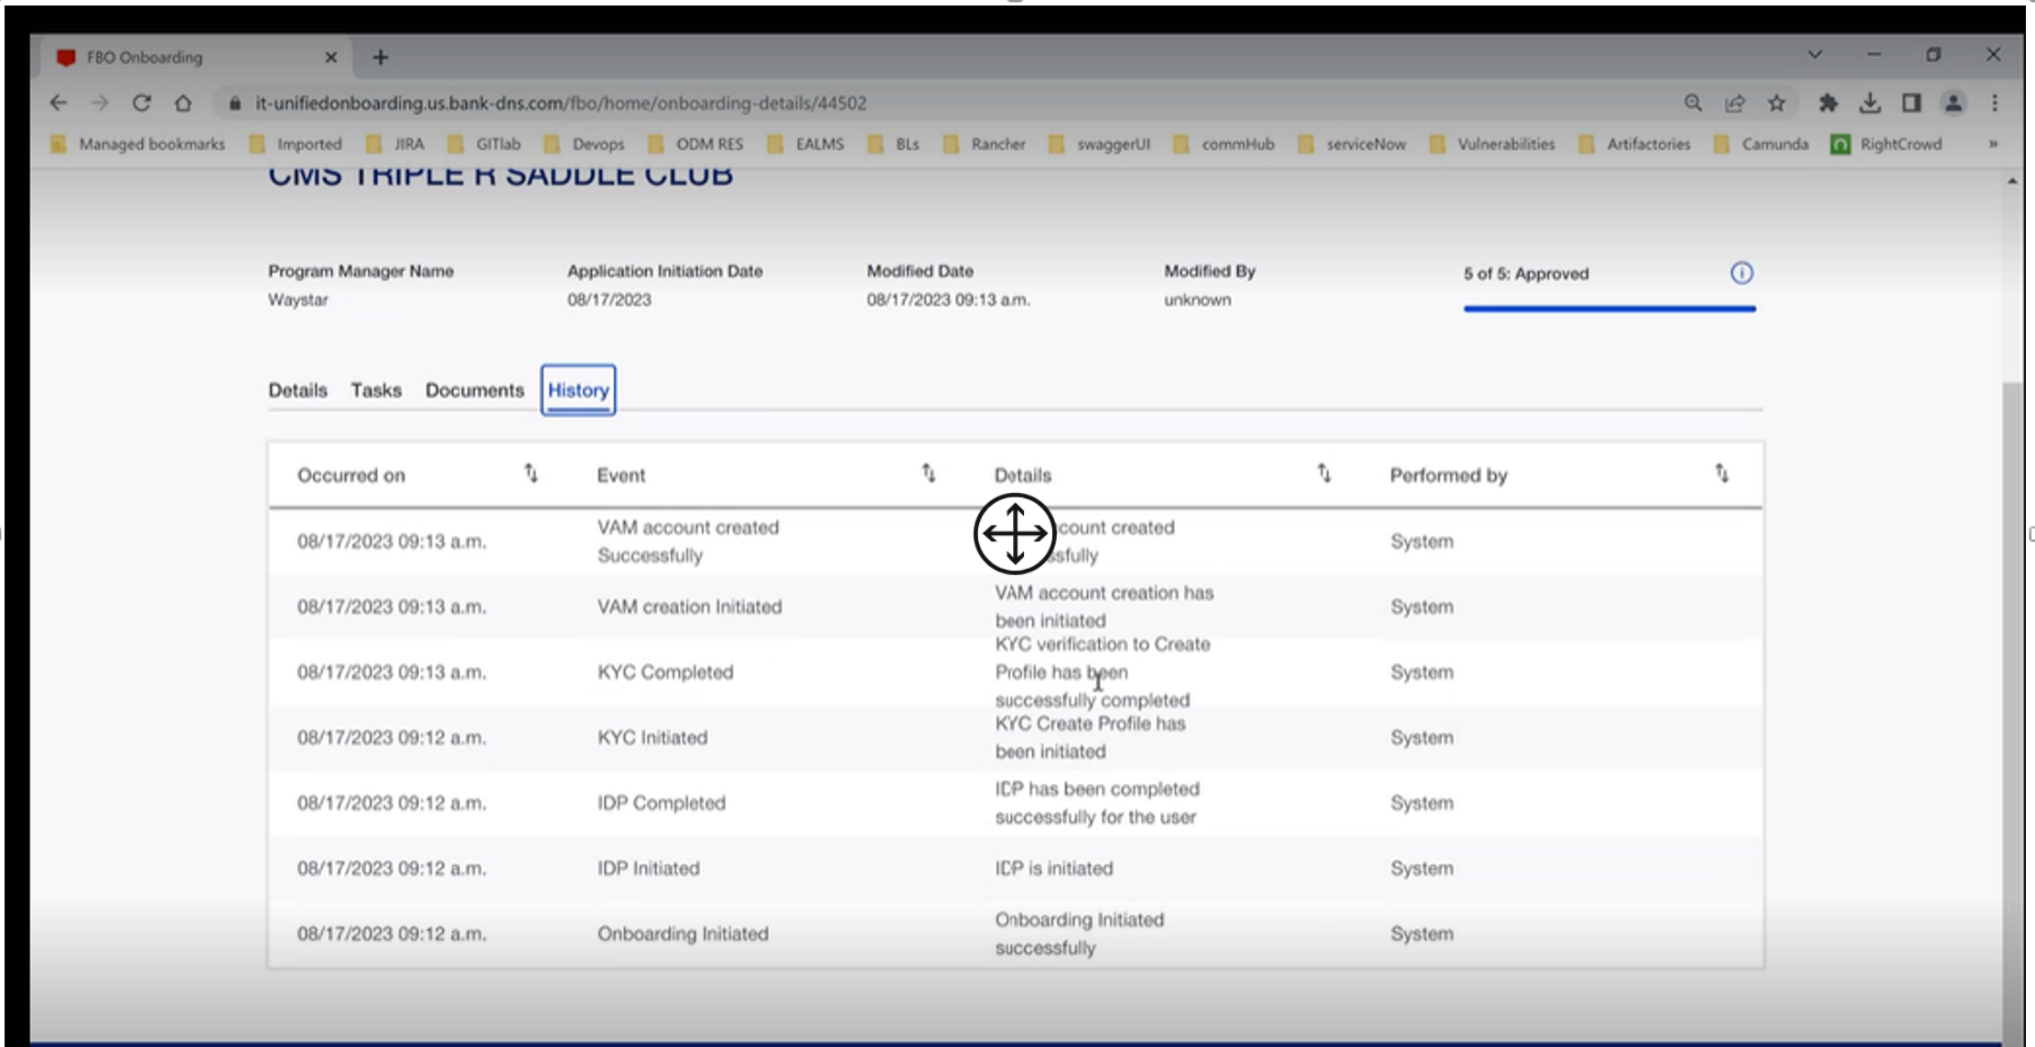
History
History
Now –
Ability to keep the audit trail at workflow activity level as well as custom user defined events
Data point level tracking and auditability feature
Usage – GFS, IT&C, GCT, PT, Money Center, FX
Roadmap –
Enhance field level audit and reporting feature
Level of reuse – High
Type of reuse – Plug and play

Slide 45
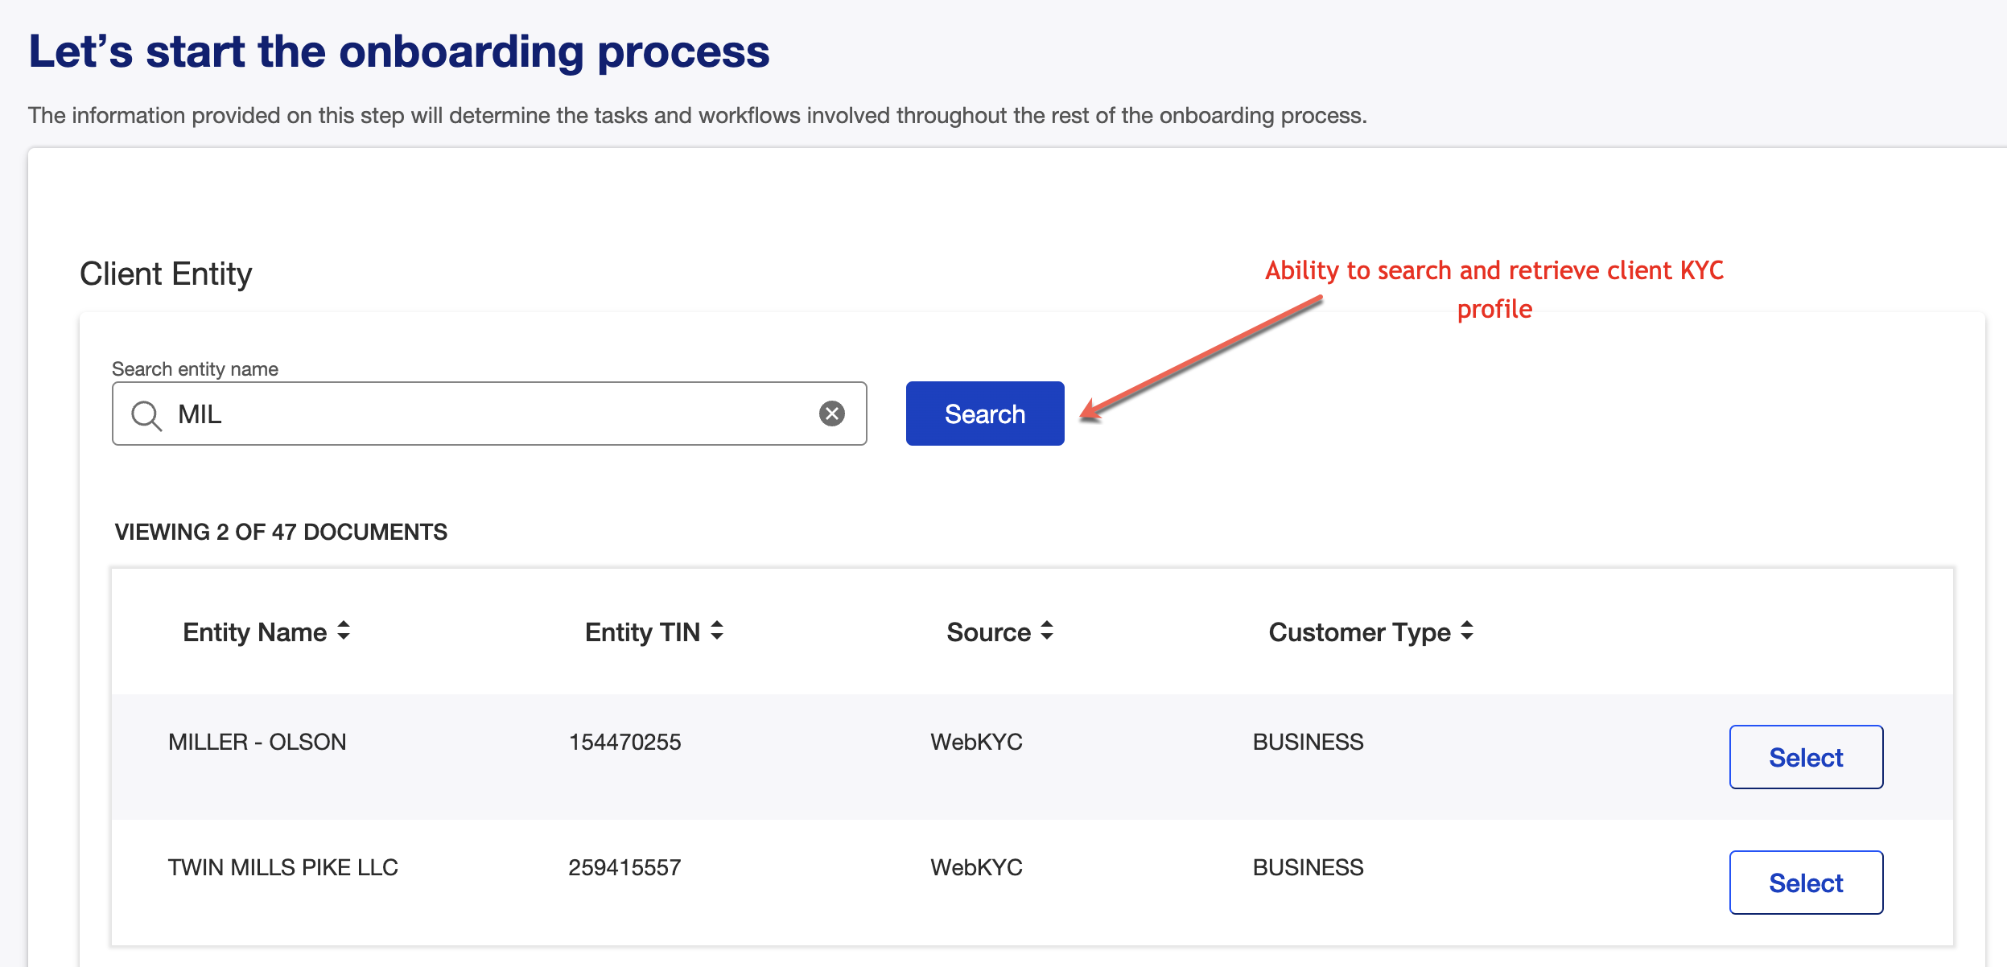
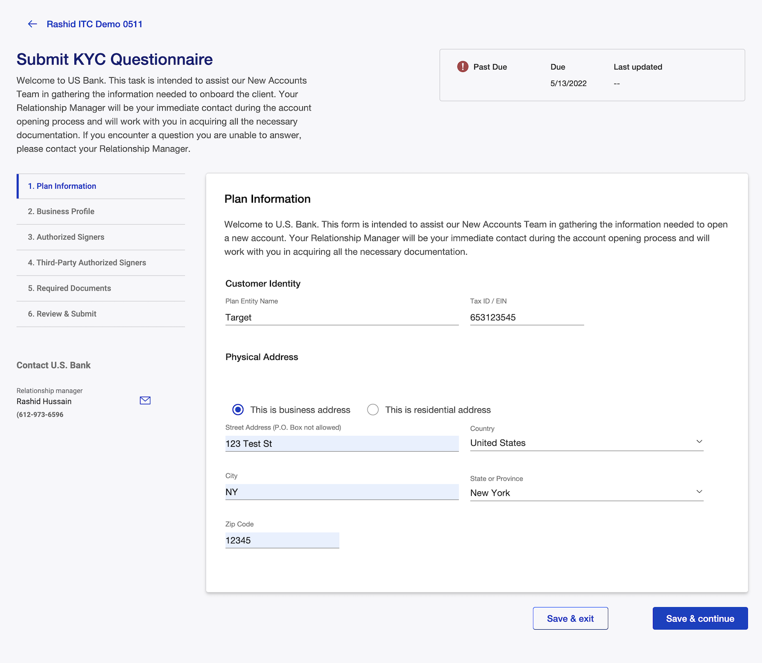
KYC
KYC Integration
Now –
Ability to search for a client in WebKYC and retrieve the profile information
Ability to create/update KYC profile in an automated fashion
Usage – IT&C, GCT, Money Center, DPG,FX, FBO
Roadmap –
Ability to view/upload KYC document to FileNet
Adopt Policy Specification API to drive KYC requirements
Level of reuse – High
Type of reuse – Plug and play

Slide 46
Appendix Capability Details
Requires Update

Slide 47









Onboarding Capabilities Details
CRM(Salesforce) Integration
KYC Integration
eSign Integration (DocuSign/OneSpan)
UX – Client/employee collaboration
Configurability
Centralized rule engine
Workflow Engine
User role/privileges
Segment/Product workflows
Global Jurisdictional
Periodic/on-demand reviews
Transaction monitoring
Auditability
Now –
Ability to push and pull salesforce opportunity data.
Avoid manual re-key in of the CRM data into onboarding platform
Usage – GFS, IT&C, GCT, PT
Roadmap – Real time data pull for Personal Trust instance
Push additional data for GFS opportunity
Level of reuse – High
Type of reuse – Reuse with coding
Now –
Ability to search for a client in WebKYC and retrieve the profile information
Ability to create/update KYC profile in an automated fashion
Usage – IT&C, GCT, Money Center, DPG,FX, FBO
Roadmap –
Ability to view/upload KYC document to FileNet
Adopt Policy Specification API to drive KYC requirements
Level of reuse – High
Type of reuse – Plug and play
Now –
Ability to initiate eSign for clients/employees using DocuSign
Orchestrate multi-signer flow
Store signed docs in FileNet
Usage – GFS
Roadmap –
Enable eSigning capabilities using OneSpan cloud – development in progress
Level of reuse – High
Type of reuse – Plug and play

Slide 48
Onboarding Capabilities Details
Dynamic Form Framework
Dynamic Data Engine
Document Management
Now –
Ability to build React based UI forms using Json metadata
Can handle varying degree of complexity to address the needs of corporate segment
Key features- Validations, error messages, simple fields, complex nested cards, tables, conditional logic, data binding, API calls, save in-progress form context
Usage – GFS, IT&C, GCT, PT, Money Center, FBO, DPG, FX
35+ distinct forms consisting of 200+ pages
Roadmap –
Form preview – inline JSON editor, Field level annotation, nested card support,
Level of reuse – High
Type of reuse – It’s a plug and play tool to build forms
Now –
It’s a flexible key/value pair based data engine​ supported by underlying microservices to perform CRUD operations
Can support Named or Generic domain APIs​
Usage – GFS, IT&C, GCT, PT, Money Center, FBO, DPG, FX
Roadmap –
Adopt corporate common object model
Level of reuse – High
Type of reuse – Plug and play
Now –
Ability to upload/download documents for employee/client persona
Configurable APIs to support multiple FileNet Doc Classes for various BLs
Ability for employee/client to collaborate for document collection/review/approvals
Usage – GFS, IT&C, GCT, PT, Money Center, FX
Roadmap –
Integrate with CMOD doc repository for DPG use case
Level of reuse – High
Type of reuse – Plug and play
UX – Client/employee collaboration
Configurability
Centralized rule engine
Workflow Engine
User role/privileges
Segment/Product workflows
Global Jurisdictional
Periodic/on-demand reviews
Transaction monitoring
Auditability

Slide 49
Onboarding Capabilities Details
Employee Dashboard
Client Onboarding Tracker
User Provisioning, Roles/Privileges
UX – Client/employee collaboration
Configurability
Centralized rule engine
Workflow Engine
User role/privileges
Segment/Product workflows
Global Jurisdictional
Periodic/on-demand reviews
Transaction monitoring
Auditability
Now –
Ability for employees to have visibility into the onboarding events
Flexibility to configure dashboard view based on the Role/BL
Ability to search/filter/sort onboarding records
Usage – Money Center, DPG,FX, FBO, GCT, PT, IT&C, FX
Roadmap – Common object model to bring consistency across BLs
Level of reuse – High
Type of reuse – Plug and play
Now –
Ability for clients to have visibility into the onboarding process
Onboarding milestone tracker
Task list, U.S. Bank Contacts
SSO from systems of engagements e.g. Pivot
Usage – IT&C, GFS, Money Center
Roadmap –
Integration with Corporate Hub – SSO and task list
Level of reuse – High
Type of reuse – Plug and play
Now –
Ability to provision client users for onboarding events
Employee user provisioning- Windows authentication based SSO, leverage LDAP groups/access management for role access
Usage – Money Center, DPG,FX, FBO, GCT, PT, IT&C, FX
Roadmap –
Enable user provisioning for SinglePoint OU for Money Center use case
Ability to search existing SinglePoint OU users from onboarding
Level of reuse – High
Type of reuse – Plug and play

Slide 50
Onboarding Capabilities Details
Centralized Rule Engine
Centralized Workflow Engine
Auditability
UX – Client/employee collaboration
Configurability
Centralized rule engine
Workflow Engine
User role/privileges
Segment/Product workflows
Global Jurisdictional
Periodic/on-demand reviews
Transaction monitoring
Auditability
Now –
Ability for non-technical users to write business rules
Enterprise grade rule engine, supports complex decision implementation
Built in testing/simulation and governance features
Role based permission management
Auditability
Usage – GFS, IT&C, GCT, PT, Money Center
1000+ rules for onboarding use case
Roadmap –
Level of reuse – High
Type of reuse – It’s a plug and play tool to write new business rules
Now –
Ability to create onboarding journeys using a web modeler
Automate complex process flows across people and systems.
Supports BPMN 2.0 specification – human activity, system activity, Integrations
Flexible architecture to support API integration into any solution
Usage – GFS, IT&C, GCT, PT, Money Center, FBO, DPG, FX
Roadmap –
Level of reuse – High
Type of reuse – Plug and play workflow tool to create new
Now –
Ability to keep the audit trail at workflow activity level as well as custom user defined events
Data point level tracking and auditability feature
Usage – GFS, IT&C, GCT, PT, Money Center, FX
Roadmap –
Enhance field level audit and reporting feature
Level of reuse – High
Type of reuse – Plug and play

Slide 51
Onboarding Capabilities Details
Periodic/on-demand reviews
Transaction Monitoring
Now –
Ability to trigger periodic/on-demand reviews
It can be a scheduled based or Event based e.g. address change
Usage –
GCT - Address change flow
Alerts/Notifications to complete onboarding tasks
Roadmap –
Implement standard periodic review processes – e.g. Update KYC every 12 months
Level of reuse – High
Type of reuse – It’s a plug and play tool to build forms
Now –
Ability to monitor transactions
Usage –
Generate review process for unpaid invoices after 90 days – Fee Setup (Entrata)
Roadmap –
Level of reuse – High
Type of reuse – Plug and play
UX – Client/employee collaboration
Configurability
Centralized rule engine
Workflow Engine
User role/privileges
Segment/Product workflows
Global Jurisdictional
Periodic/on-demand reviews
Transaction monitoring
Auditability

Slide 52
Onboarding Capabilities Details
Fee Schedule Editor
UX – Client/employee collaboration
Configurability
Centralized rule engine
Workflow Engine
User role/privileges
Segment/Product workflows
Global Jurisdictional
Periodic/on-demand reviews
Transaction monitoring
Auditability
Now –
A database driven capability to manage fee schedule
Ability to fetch standard fee schedules and allow employees to make changes to cater to the needs of a given onboarding
Ability to track changes.
Usage – GFS
Roadmap – NA
Level of reuse – Medium
Type of reuse – Reuse with coding

Slide 53
Unified Onboarding Platform - Roadmap
UO MVP 1.0
UO Core MVP 1.0
2020
2021
2022
2023
Business line specific requests
Move away from BPM UX to using BPM UI & Angular
Identify common patterns for re-use
Business line specific requests
Introduce React UI development
Create Smart forms for data capture
Create reusable templates library
Create dynamic data engine
Use BPM API's for events and workflow
Business line specific requests
Introduce Camunda as open source workflow engine
Use BAW headless as workflow engine
Create reusable templates for KYC
Expand Smart forms capabilities
Move to UO Core – product offering
Standardize customer experience – Customer collaboration portal
Standardize employee experience – Employee collaboration portal
Customized workflow and data capture
Define common objects to maximize reuse
Introduce customer API to select bank customer early in the process
Now
Define CORE & Product acceptance criteria.
For accepted products, set up new products in 2-4 months
Create common employees experience
Create common client experience
Create common object model
Extend the role management to support common objects
Next
Determine if BL willing to adopt a common platform. Test market the application. Are custom enhancements required.
Document the CORE product and cross train product, UX and dev teams.
Create a new intake process to deploy CORE quickly
Create a onboarding workflow
Stand up sharepoint site to market benefits of CORE
Establish CORE team and Technical product owner
Later
Determine success criteria for CORE
Measure success or custom requirements
Extend core or drop Core (go back to custom reuse)
UO Core platform = MVP 1.0 available EOY 2023
UO Sales and Marketing to PO, UX designers, Dev teams– Training completed by Q1 2024
UO Onboarding use – CCB Digital Capex plans to use for Global trade

Slide 54
Appendix - OLD version do not USE

Slide 55
CORE MVP Roadmap
Employee Dashboard
Roles
Sales, FO, MO, BO
Data Filtering
Standard View by Role
Milestone View
Tasks
Common all BL
Common Roles
Common Objects
Configure by PM by Roles
Common Api’s
Event Details
Static list of tabs
Details
Tasks
Documents
Client Connect Access
History
Dynamic BL defined tabs
Configurable by PM by user
Configurable by PM by role
USBNA Customer Dashboard
Customer OB Events
Milestone tracker
USB Contacts
Task list
Client e-mail
Client OTP
Corp Connect
USB Customer
Search/Prefill
USB Customer Search- Hogan CIS
Global search GLIEF
Global Search D&B
Customer data prefill GLEIF
Customer data prefill D&B
Create customer in Hogan
CIP
Common User experience
Green scenario
Amber Mgmt
CIP Widget
KYC
BL User Experience
Search/Get KYC
Update KYC – API
Update ad Create Corp KYC
Integrate KYC Policy API
Document collection based on Policy
KYC Widget
Corp Connect
USB Brand
USB Acct List
OTP
Onboarding Dashboard
Messaging
Message personas
90%
1 Qtr
70%
1 Qtr
90%
1 Mo
3 Mo
1 Mo
90%
75%
90%
50%
6 Mo
90%
6 Mo
3 Mo
00%
2024
BL Rollout
MC, DPG/FX
All new journeys – auto
Create 1st product e2e
2024
BL Rollout
Static List
All new Journeys
Create 1st product e2e
2024
BL Rollout
Client OTP
All new Journey’s with Client experience
Create 1st e2e product
2024
BL Rollout
Client OTP
All new Journey’s with Client experience
Create 1st e2e product
2024
BL Rollout
All new Journey’s
Create 1st e2e product
2024
Create KYC Widget
Create KYC
Policy API
BL Rollout
All new Journey’s Create 1st e2e product
2024
BL Rollout
All new Journey’s Create 1st e2e product
2024
Create Messaging
BL Rollout
Create 1st e2e product
Dependencies
Training
Journey Teams
Map roles
Map Common Objects
Product
Gain adoption
Map existing product to common objects
Dependencies
Journey Teams
Map roles
Map Common Objects
Product
Gain adoption
Map existing product to common objects
Dependencies
Journey Teams
Map roles
Map Common Objects
Product
Gain adoption
Map existing product to common objects
Dependencies
Create Hogan CIS
API for all requirements
Dependencies
Amber Design
Workflow
Dependencies
UX Design
Workflow
Policy
Stories
Dependencies
Corp Connect
Authentication
Stories
Dependencies
Stories
Prioirty
MVP ready state
Required for MVP (included in time est)
Delivered later not in % Complete and not in MVP timeline

Slide 56
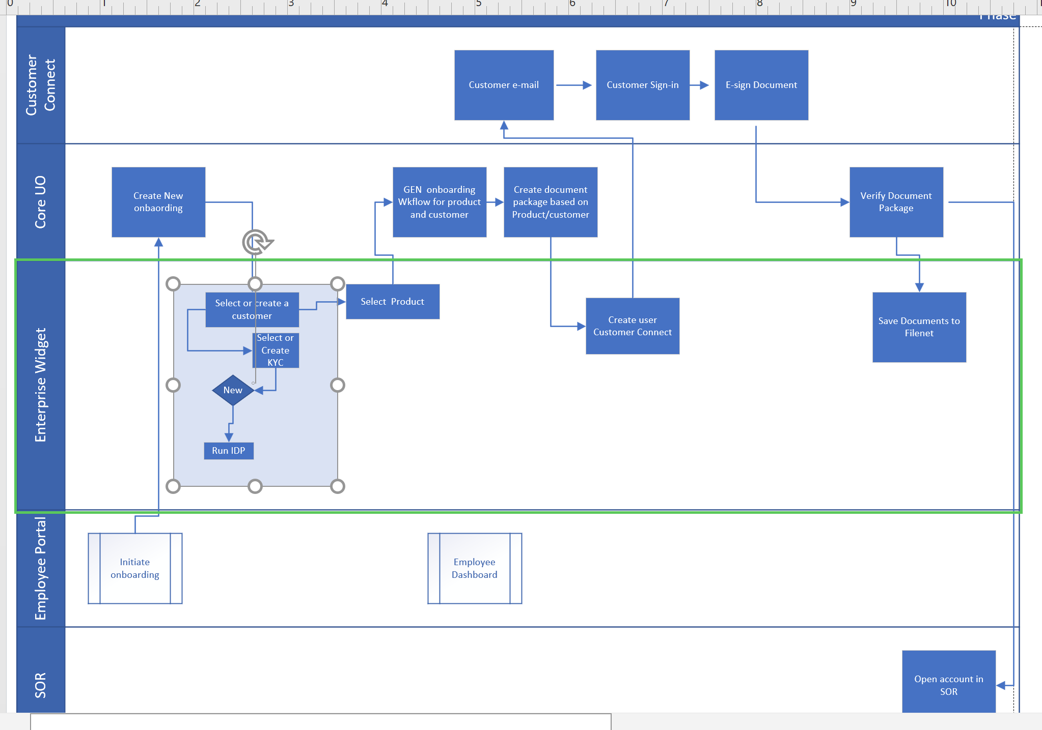

Slide 57
Onboarding CORE Technical Taxonomy
Initiate Onboarding
Manual entry
Onboarding Event Management
Employee Dashboard
Client Dashboard
Customer 360 View
Customer
Tasks
Documents
Grant Access
Audit
Tasks Management
Default/Basic
Audit
Document Management
Communication
Portals
Employee Login
Customer Login
AD – UO URL
Sales Team only
Corp Connect
Employee Tasks
Initiate Onboarding
Salesforce Push
Public API
Batch Upload
Manual Entry
Portals/Sites
Corp Connect
OTP
Sign-in
Pivot
Dept Portal
Onbase
Singlepoint
Additional Operations Teams
Specific Dashboards
Create Onboarding
Rules set up
Workflow create
Rules set up
By Product
By Client Type
Document Listing
Disclosures
Doc to esign
Tasks shared in Corp Connect
E-mail communications
All activity captured and available
Role Data
Customer Persona
Sales Rep
KYC Data
IDP Data
Entity Data
Initiate Onboarding
Manual entry - Sales
Common Objects
Roles – Customer Persona,
KYC
IDP
Entity – USB Entity,USB ID, Hierarchy, RM info
Product
Events
Milestones
Process meta data
Task Meta data

Slide 58
Onboarding CORE Technical Taxonomy
Draft
Common UI/UX
React
Shield
Shield 2.0
Smart Form Framework
Employee Dashboards
Event details
Tasks details
Client Dashboards
Tasks
Custom Dashboards
API
Common
SOR
Enterprise
Java Springboot
UO Systemic Api’s
Form
Milestone
Task
Workflow
Visual Create
Camunda
BAW
Business Rules Engine
Business rules Spreadsheet
Enterprise Common Capabilities
KYC
IDP
Document Mgmt
PDF Viewer
Filenet
CMOD
Document generation
e-signature
Dynamic Data Engine
Common UI/UX
Dashboards
Event details
Tasks details
Custom Dashboards
Data Base - ElastaSearch
SQL Server
Common Objects

Slide 59
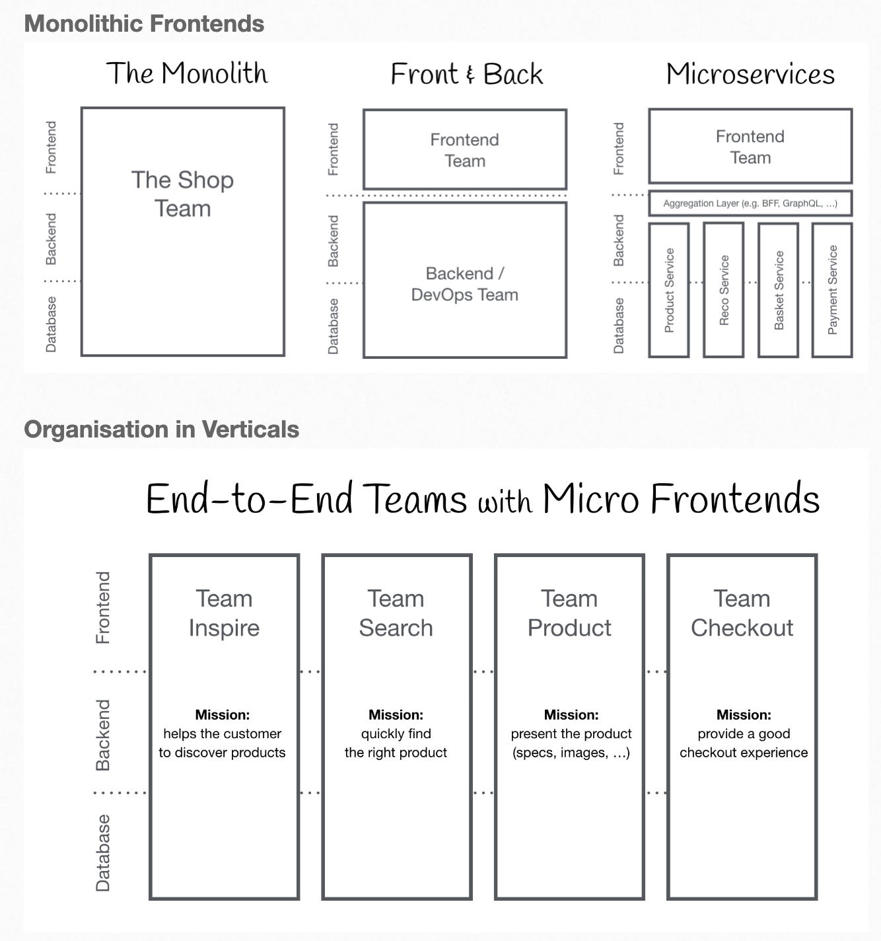
https://micro-frontends.org/

Slide 60
Collaboration Portal
CUO Collaboration Portal(Client)
CUO Collaboration Portal(Emp)
EO Collaboration Portal
CUO Event Service
Camunda
UO DB

Slide 61
Approaches
Hybrid
Single Run-time
Common collaboration portal as L1 dashboard
Common Object Model
Deploy Core platform APIs as single instance
Single runtime instance of Common Workflows, e.g. CIP/KYC, Hogan CIS/DDA
Develop instance of Core (Collect client data, CIP verification, KYC, Open DDA/Virtual Account)
BL with specific needs to have their own stitching layers(Frontend/Experience API/Workflow)
All UI apps to leverage shared UI assets
Single runtime approach was adopted initially for GFS/ITC/GFS where we had one runtime app.
Advantages –
Parallel development - Various BLL are in different stages of modernization journey
Scale independently based on BL needs, e.g. FBO is a high volume use case compared to MC/DPG
Independent deployment
No Implementation dependencies
Less complex test scenarios and test effort
Per latest Microfrontend approach (same as microservice for backend) - don't build one Single Page application, different use cases, different needs. Accept some inefficiencies, like not building backend monolith.
Challenges –
Having single run-time for multiple BLs approach was tried for IS business lines, (GFS/ITC/GCT)
Difficult to manage parallel development
Release planning, all BLs have their own release schedule
Plan for multiple branches testing and deployment, e.g. 2 BLs wants to go for a release together or have separate release dates, keep one branch for each BL and one with combined code
Running parallel UAT cycle, which code to expose to users

Slide 62
UO Apps - 2023

Slide 63
Now Next Later
Presentation Layer
Dashboards
Event Details
Task Details (Exclude)
API/Data
Corporate Common Objects
Common APIs
Workflow
Collect Client Data
CIP
KYC
Hogan CIS/DDA
Workbench
Form Designer
Workflow Designer

Slide 64
Opportunity Setup
GFS Salesforce
Fee Modeling
Fee Proposal
Fee proposal
Digital Acct Opening Packet
Contracts
Digital Packet Creation
Fee Negotiation
GCT Salesforce
Other
CIP Decision Engine
OneKYC
Omni KYC
Web KYC
Web
eSign
OneKYC
IDP/KYC Dashboard
Update
Upload Docs
Manage KYC
Pre Sales/Sales
KYC/AUTH
Employee Dashboard
Event List
Status
Event Details
Client
Tasks
Task Details
Data
Documents
History
New Client User Provisioning
Milestones
Tasks
Initiate Onboarding
Common Intake
Documents
Employee Experience
Client Dashboard
Onboarding Events
Onboarding Tasks
Tasks Details
Data Entry Form
Documents
Common Intake
eSign
Client Experience

